Slide 1

SMART NAVIGATION SYSTEM FOR
VISUALLY IMPAIRED PEOPLE
Project ID - 2022 - 227
SMART NAVIGATION
01

Slide 2
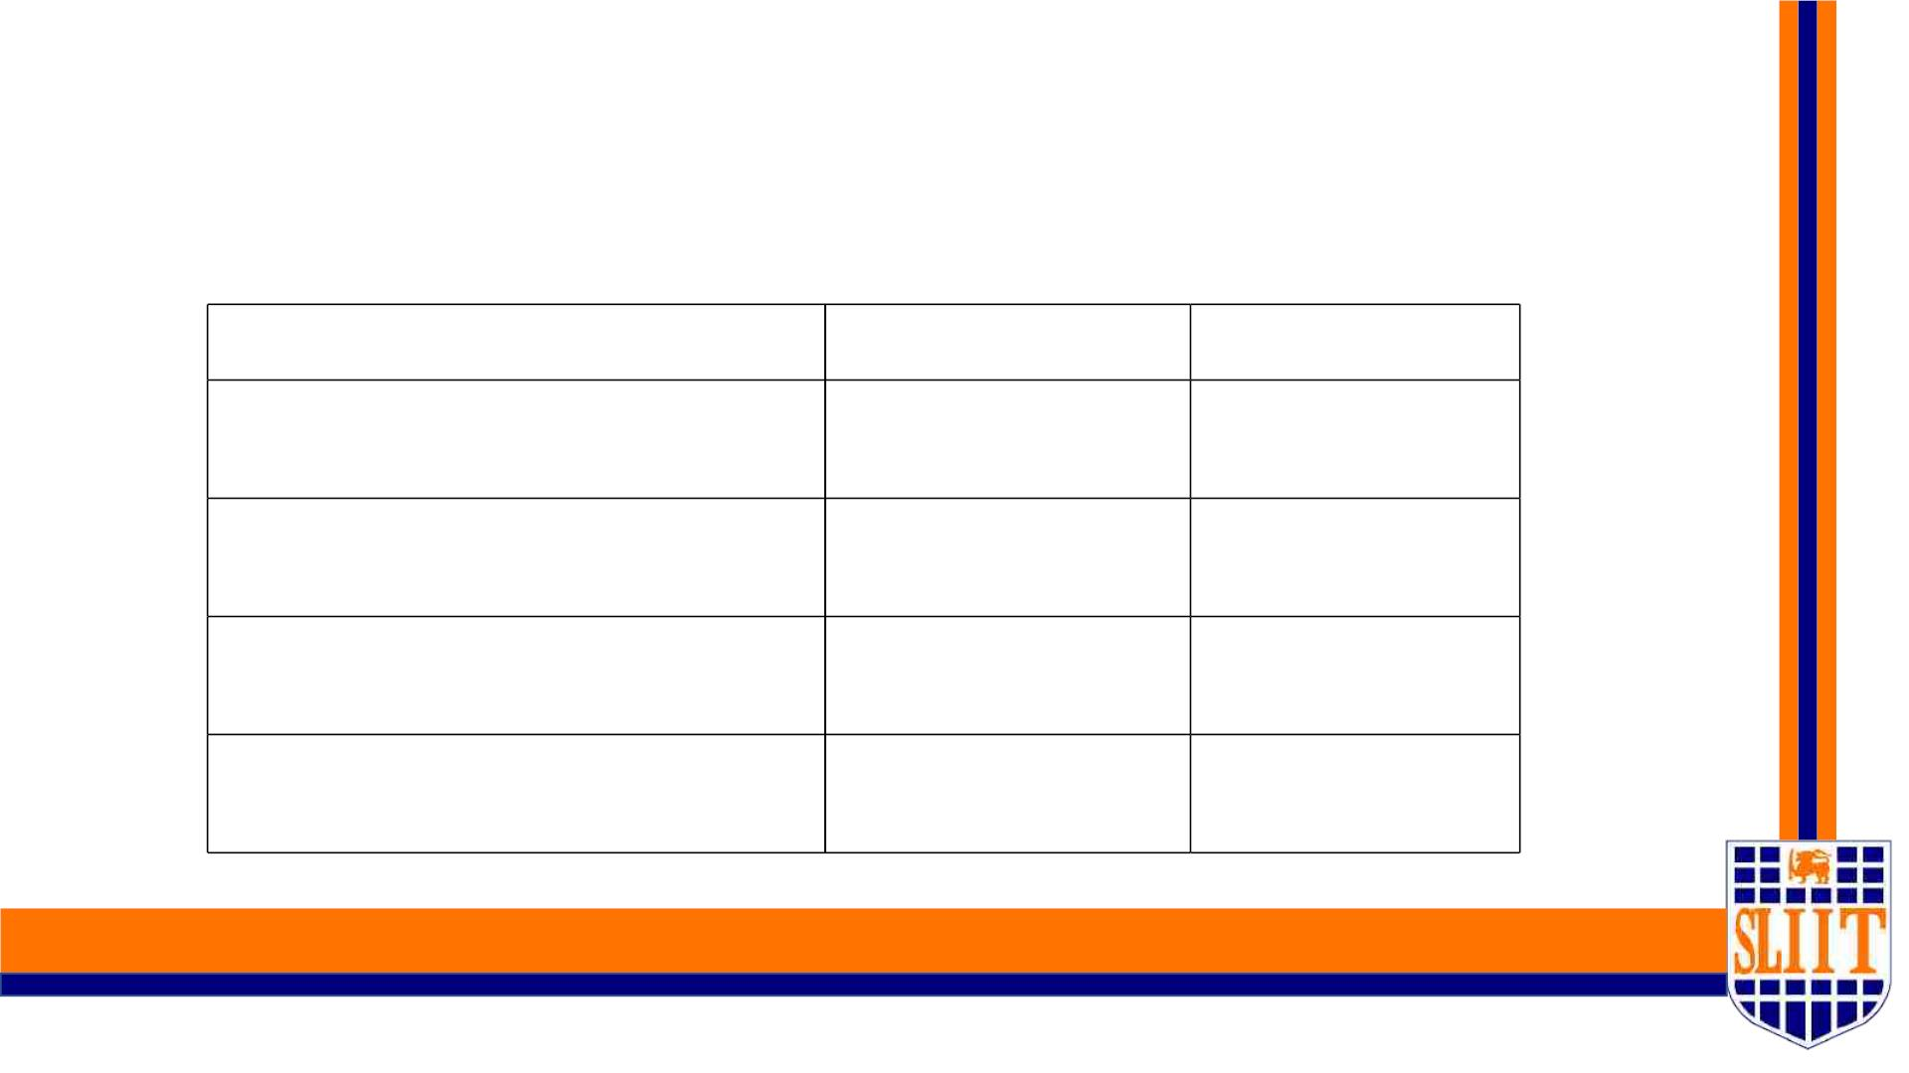
Project Supervisor - Ms. Sanjeevi Chandrasiri
Members
Student Name
Student ID
Specialization
Jathusanan.E
IT 19049878
SE
W.R.J.M.Weragoda
Madushan.W.A
IT 19008424
IT 19042152
IT 19109190
SE
SE
SE
S.R.D.Sudaraka Keshara
SMART NAVIGATION
02

Slide 3

Introduction to the
Project
SMART NAVIGATION
03

Slide 4

Overall Project Description
Ø We are implementing a system which can be used as a guide for those who are
visually handicapped.
Ø Through our application for visually impaired people, we are attempting to
improve self-sufficiency.
Ø The key features that we intend to implement through our application are walk
lane detection, road sign detection with APS system, surface and pothole
detection with obstacle detection, and relative face recognition.
Ø These features have been implemented with the help of image processing and
machine learning.
SMART NAVIGATION
04

Slide 5
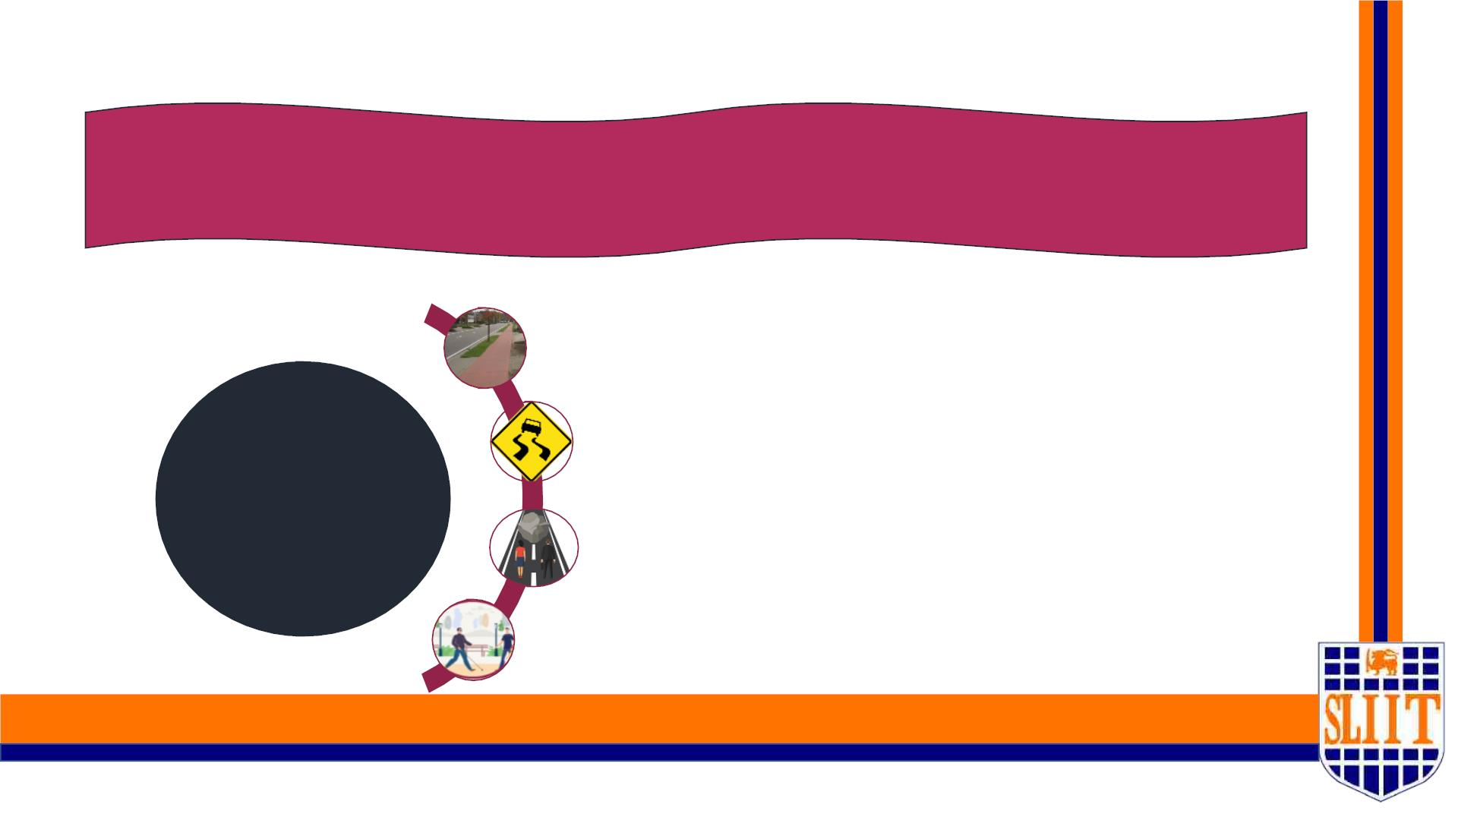
Main Research Objective
Our research recommends a smart gadget for visually impaired people to help them
navigate around the outside world.
Smart walk-lane detection & navigation in the main roads.
APS system with Road Sign Detection when
walking.
Sub
Objectives
Pothole and surface detection with obstacle detection
when walking in the surroundings.
Make Ease the detection of family, relatives and friends.
SMART NAVIGATION
05

Slide 6
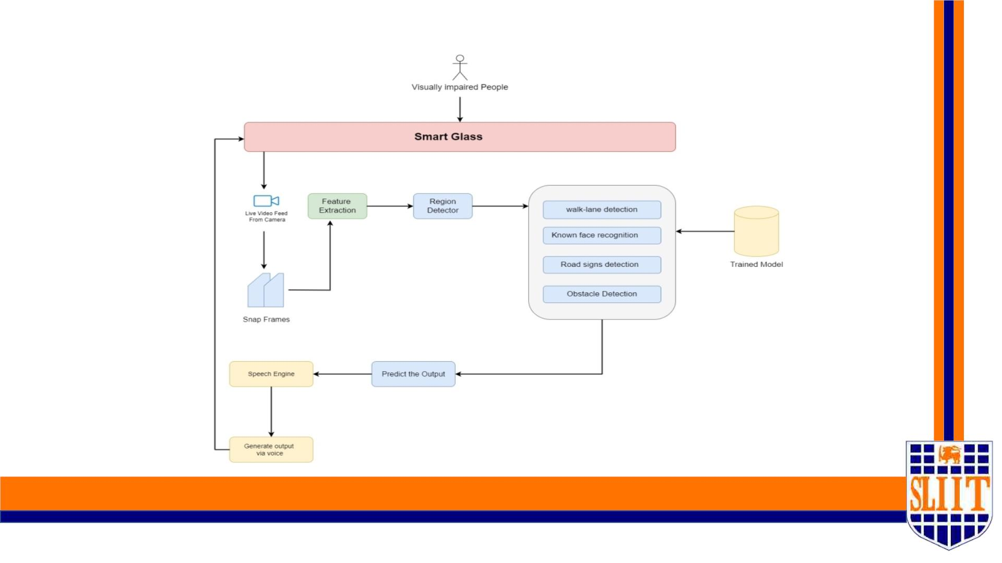
System Overview Diagram
SMART NAVIGATION
06

Slide 7
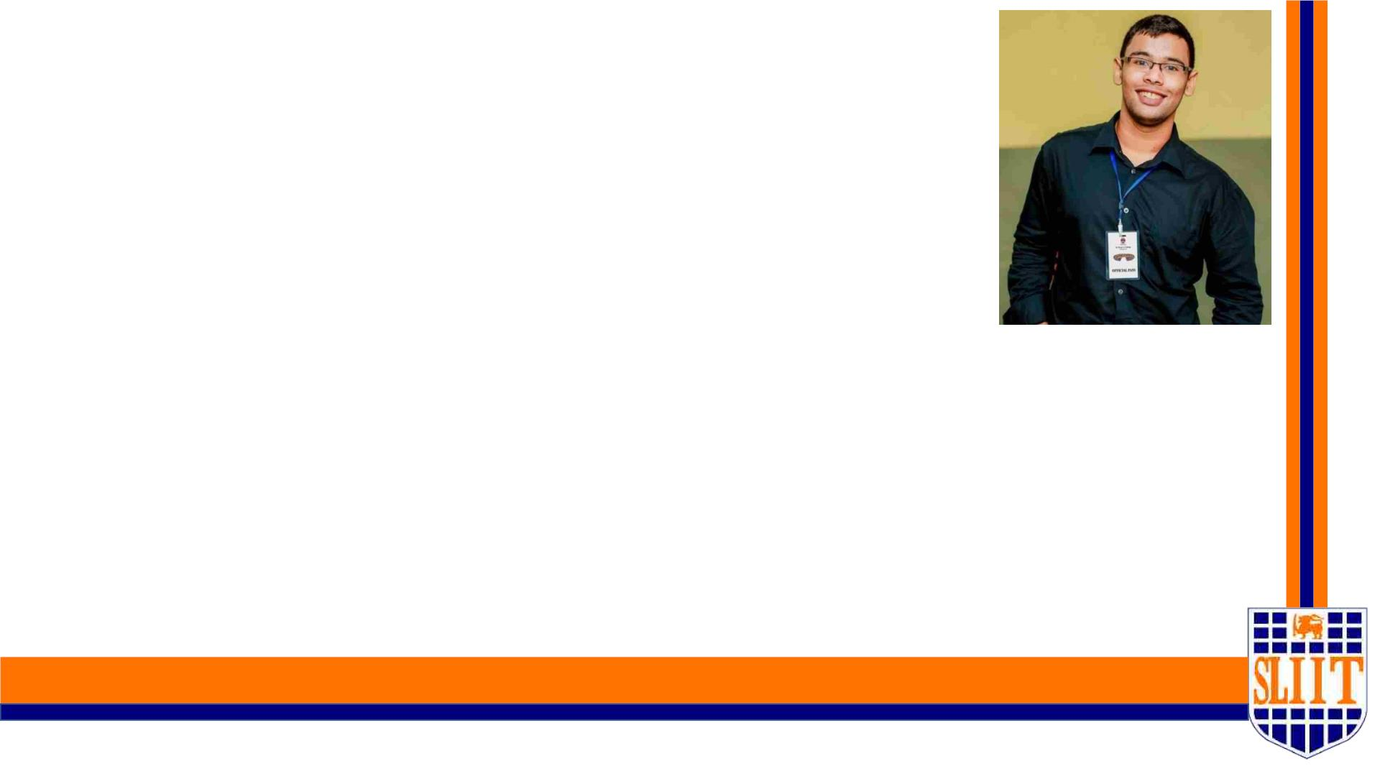
IT19109190 | KESHARA S.R.D.S
SPECIALIZATION : SE
SMART NAVIGATION TOOL FOR VISUALLY IMPAIRED PEOPLE
07
IT19109190 | KESHARA S.R.D.S | 2022-227
7

Slide 8
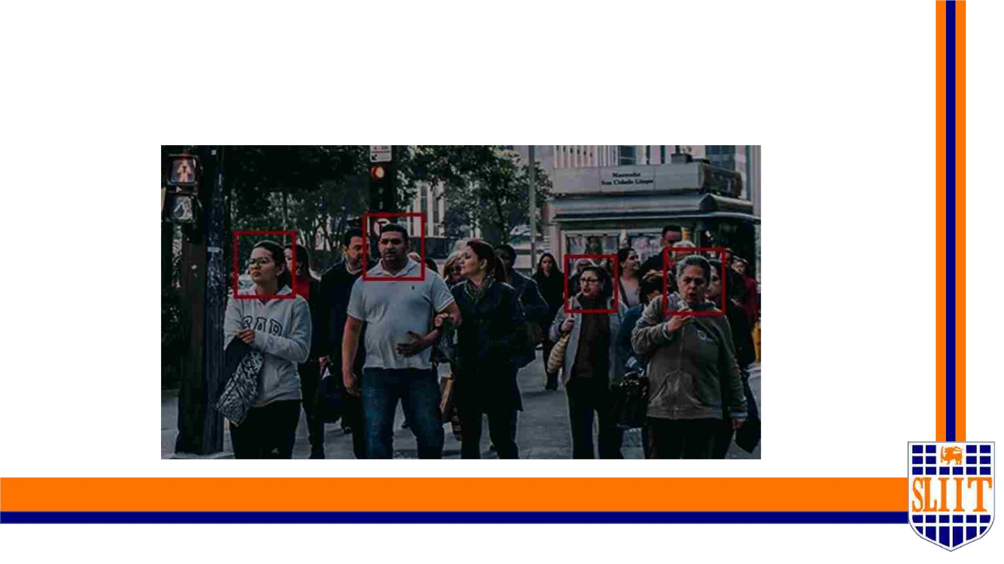
FACE RECOGNITION OF KNOWN
INDIVIDUALS
SMART NAVIGATION TOOL FOR VISUALLY IMPAIRED PEOPLE
08
IT19109190 | KESHARA S.R.D.S | 2022-227
8

Slide 9

Research Question
When considering the solutions that have been implemented to support the
visually impaired community, the use of Electronic Travel Aids (EDA) has
become immensely popular however these devices lack several important
features when it comes to overcoming problems such as identifying a known
individual of the user in various environments. Many EDAs need to implement
this feature to overcome certain shortcomings faced by the user.
SMART NAVIGATION TOOL FOR VISUALLY IMPAIRED PEOPLE
09
IT19109190 | KESHARA S.R.D.S | 2022-227
9

Slide 10

Research Question
• Lack of ability to recognize known individuals by the user to obtain assistance in
terms of an emergency or just for a casual meet and greet.
• Users just tend to their normal walk routine using current EDAs without such a
feature.
• This causes the user to become one sided in interacting with society and tend to
cause further emotional stress for the user.
• Integrating this feature with Image processing algorithm allows the users to
identify and interact freely with their social circle.
SMART NAVIGATION TOOL FOR VISUALLY IMPAIRED PEOPLE
10
IT19109190 | KESHARA S.R.D.S | 2022-227
10

Slide 11
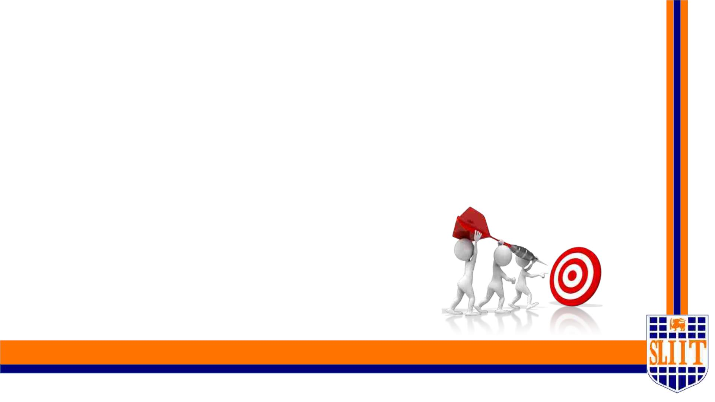
Main objective
Develop a face detection algorithm for known
individuals of the visually impaired user so that
the user can easily locate his/her loved ones and
obtain assistance when needed.
SMART NAVIGATION TOOL FOR VISUALLY IMPAIRED PEOPLE
11
IT19109190 | KESHARA S.R.D.S | 2022-227
11

Slide 12

Specific objectives
v Storage of biometric data of each known individual of the user
v Assignment of key identifiers for individuals.
v Voice output feature to be implemented when individual is successfully
identified.
v Distance calculation between user and known individual.
v Partial face detection feature when the individual is facing the user at an angle.
SMART NAVIGATION TOOL FOR VISUALLY IMPAIRED PEOPLE
12
IT19109190 | KESHARA S.R.D.S | 2022-227
12

Slide 13
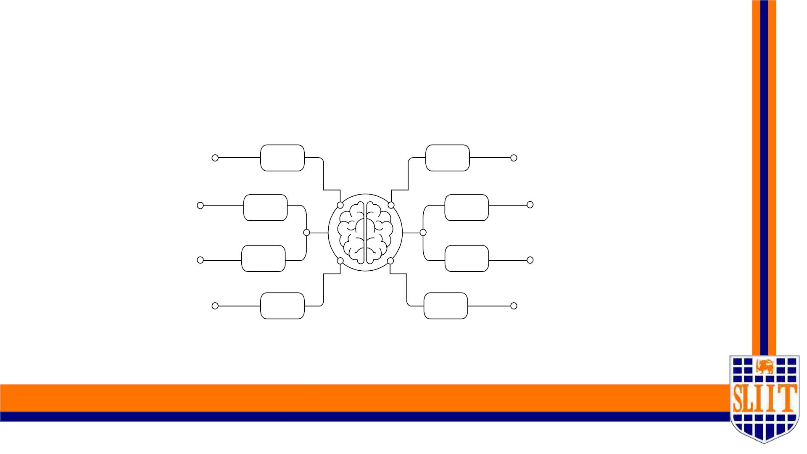
Research Methodology
SMART NAVIGATION TOOL FOR VISUALLY IMPAIRED PEOPLE
13
IT19109190 | KESHARA S.R.D.S | 2022-227
13

Slide 14
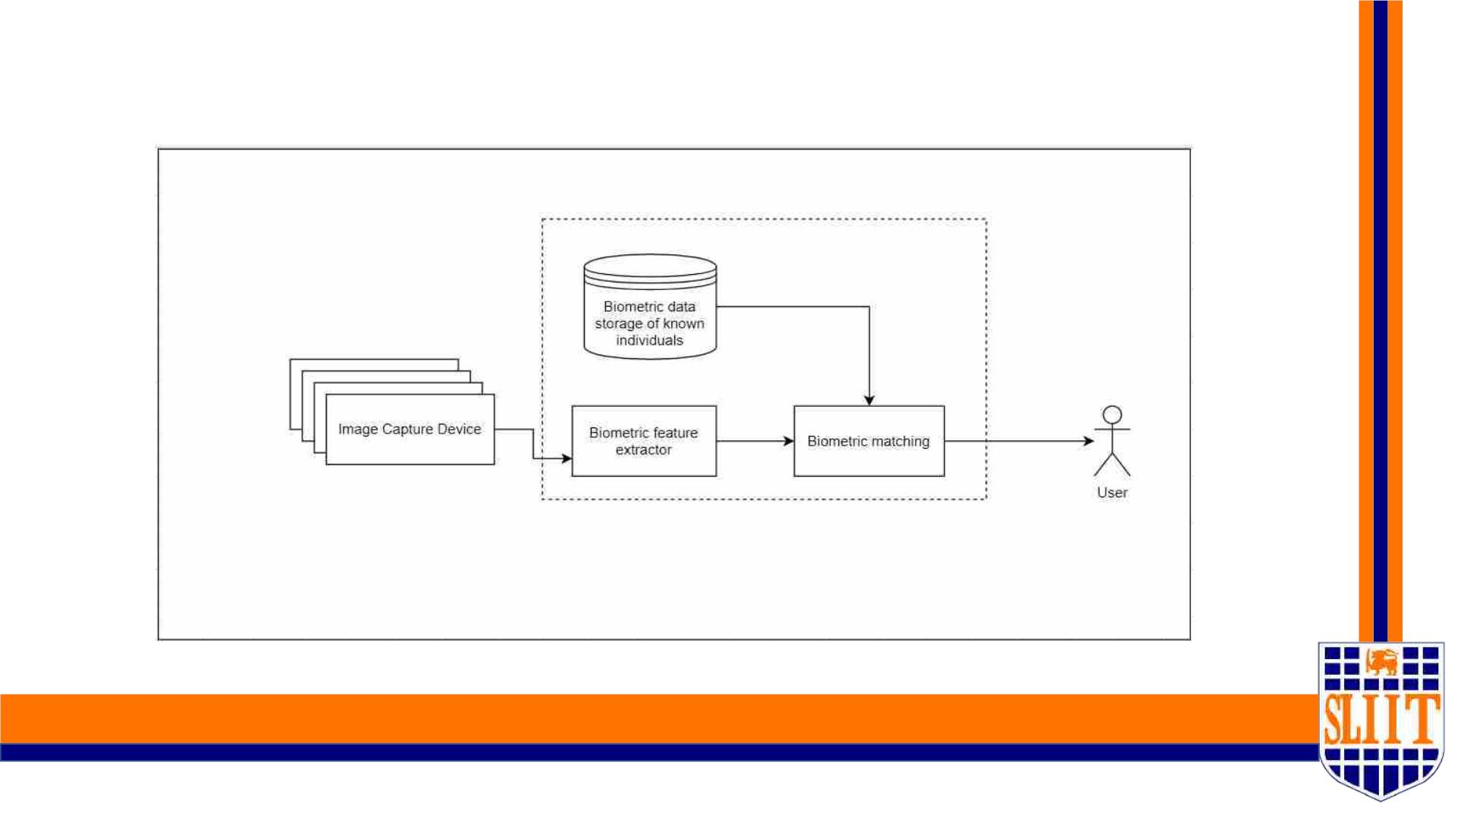
System diagram
SMART NAVIGATION TOOL FOR VISUALLY IMPAIRED PEOPLE
14
IT19109190 | KESHARA S.R.D.S | 2022-227
14

Slide 15
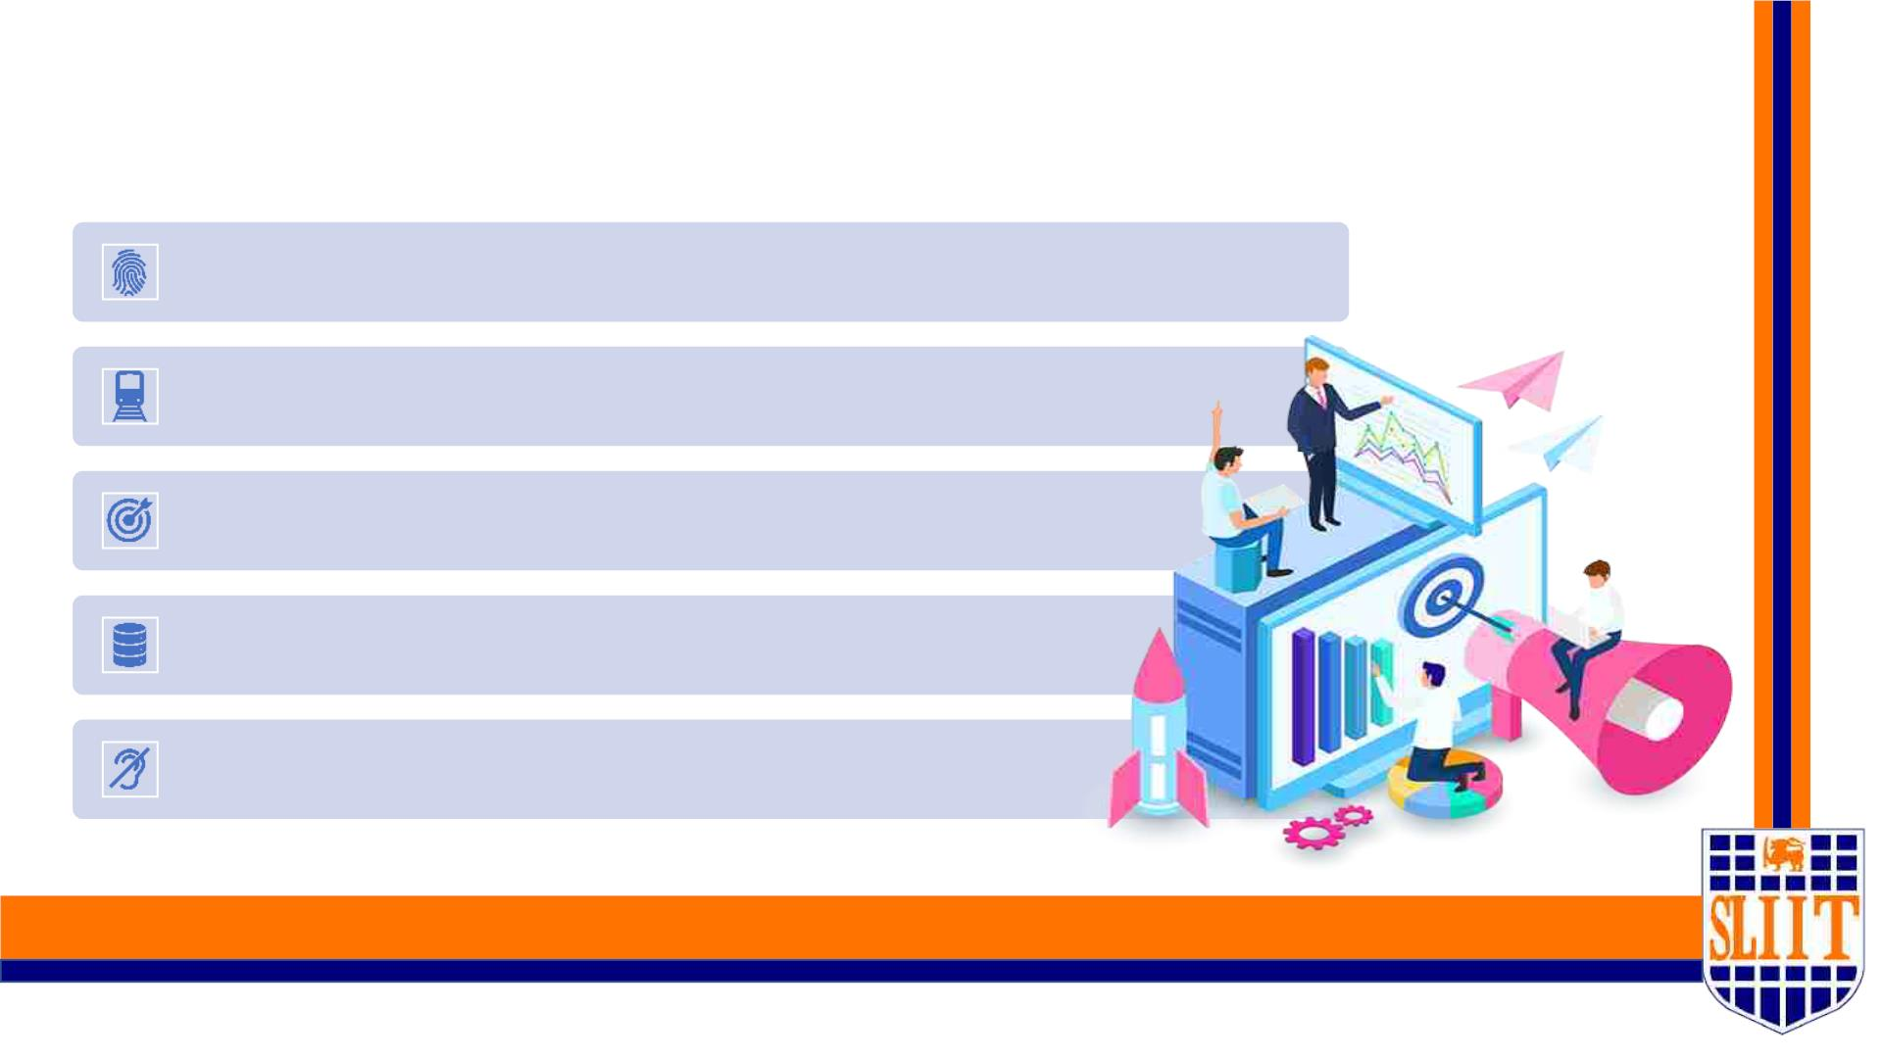
Methodology Major Phases
Data processing of biometric features of each individual known to the user.
Train and test the model.
Analysing the model accuracy.
Make decisions using output data.
Notify User via Voice Notifications.
SMART NAVIGATION TOOL FOR VISUALLY IMPAIRED PEOPLE
15
IT19109190 | KESHARA S.R.D.S | 2022-227
15

Slide 16
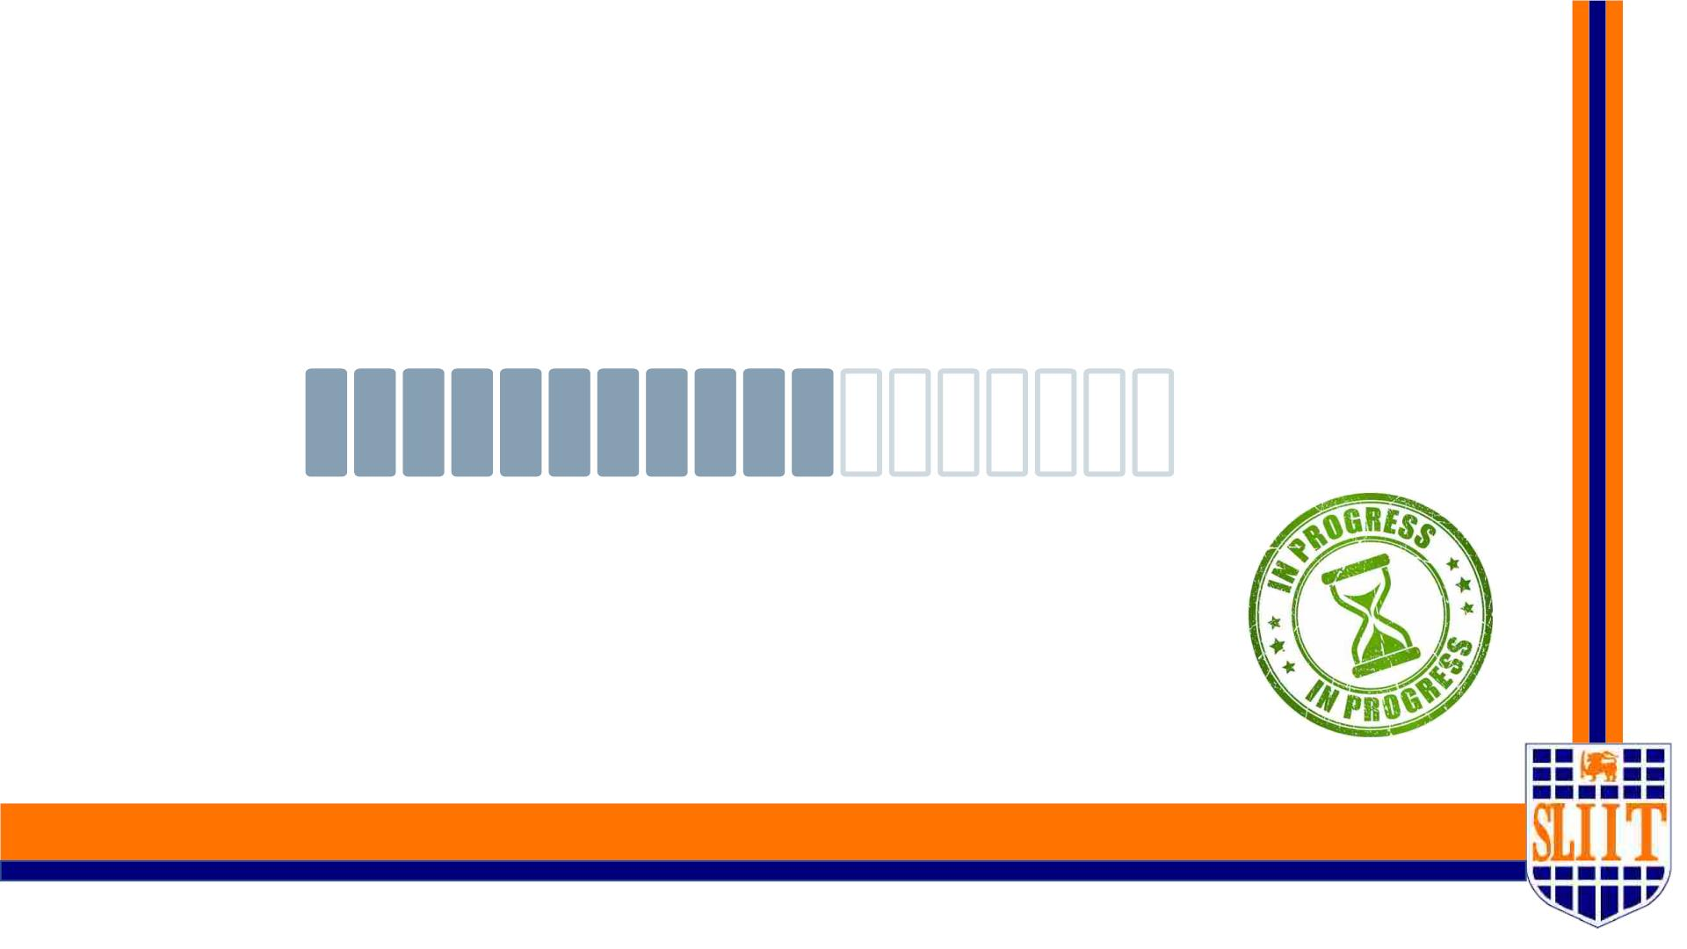
Project Completion – 50%
SMART NAVIGATION TOOL FOR VISUALLY IMPAIRED PEOPLE
16
IT19109190 | KESHARA S.R.D.S | 2022-227
16

Slide 17
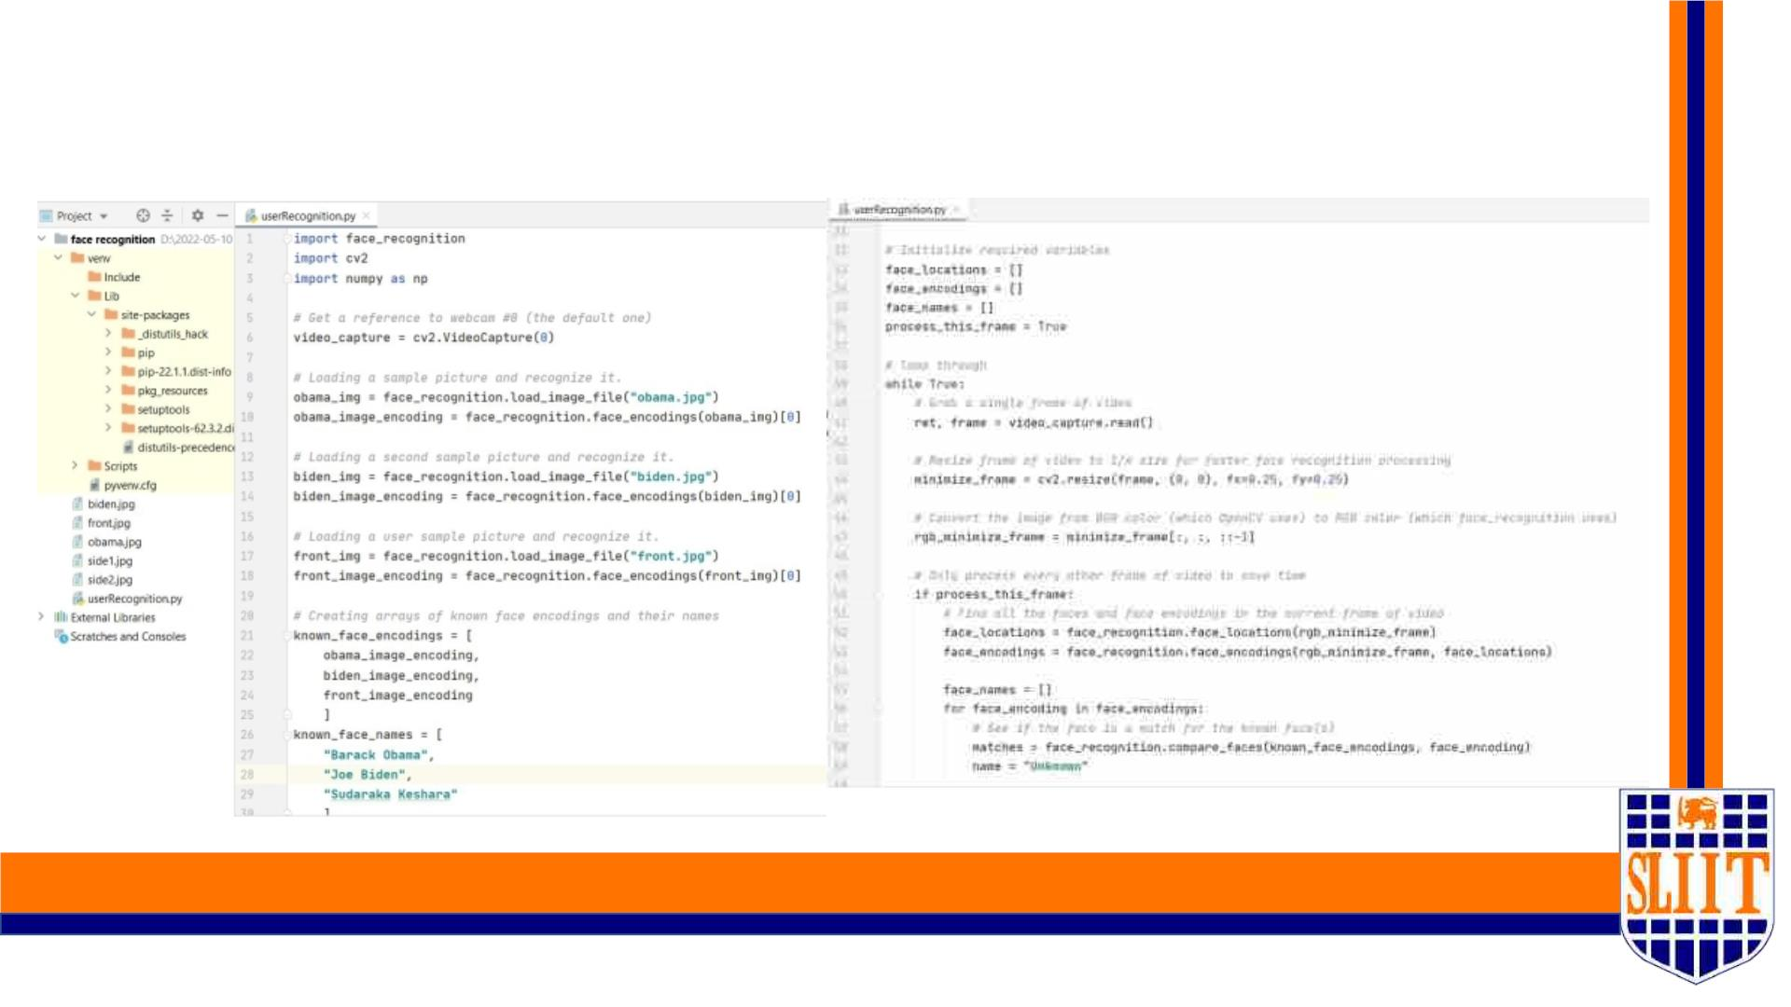
Code implemented for the facial recognition
algorithm
SMART NAVIGATION TOOL FOR VISUALLY IMPAIRED PEOPLE
17
IT19109190 | KESHARA S.R.D.S | 2022-227
17

Slide 18
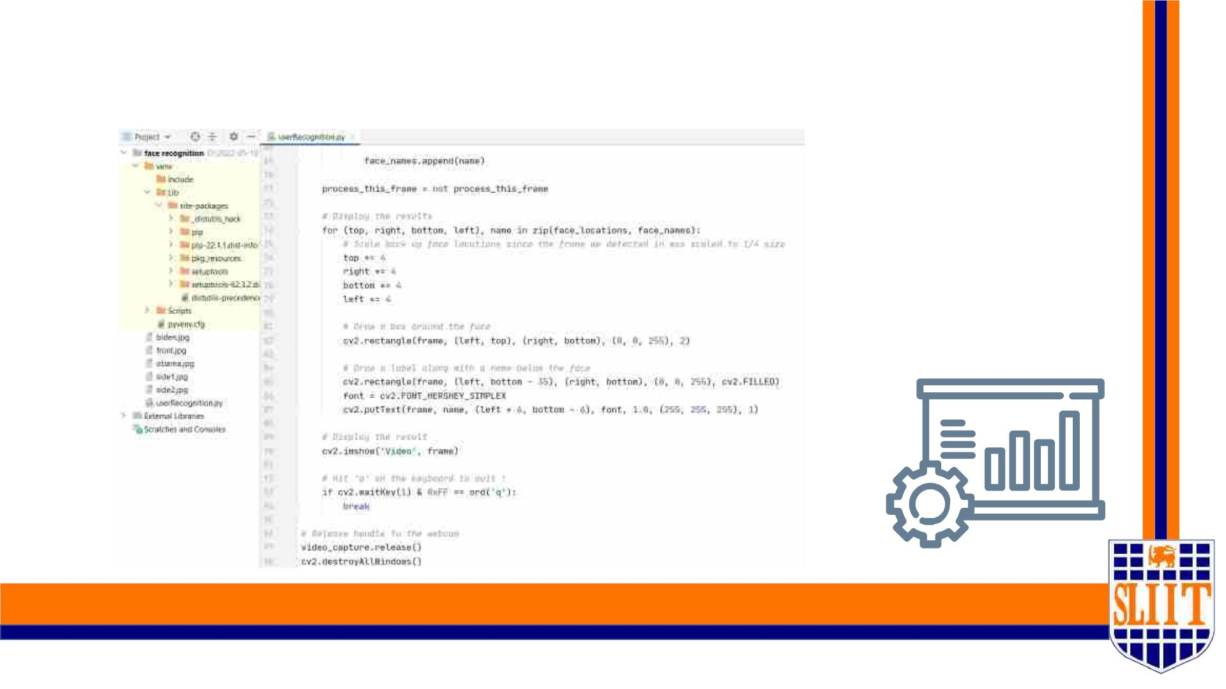
Code implemented for the facial recognition
algorithm
SMART NAVIGATION TOOL FOR VISUALLY IMPAIRED PEOPLE
18
IT19109190 | KESHARA S.R.D.S | 2022-227
18

Slide 19
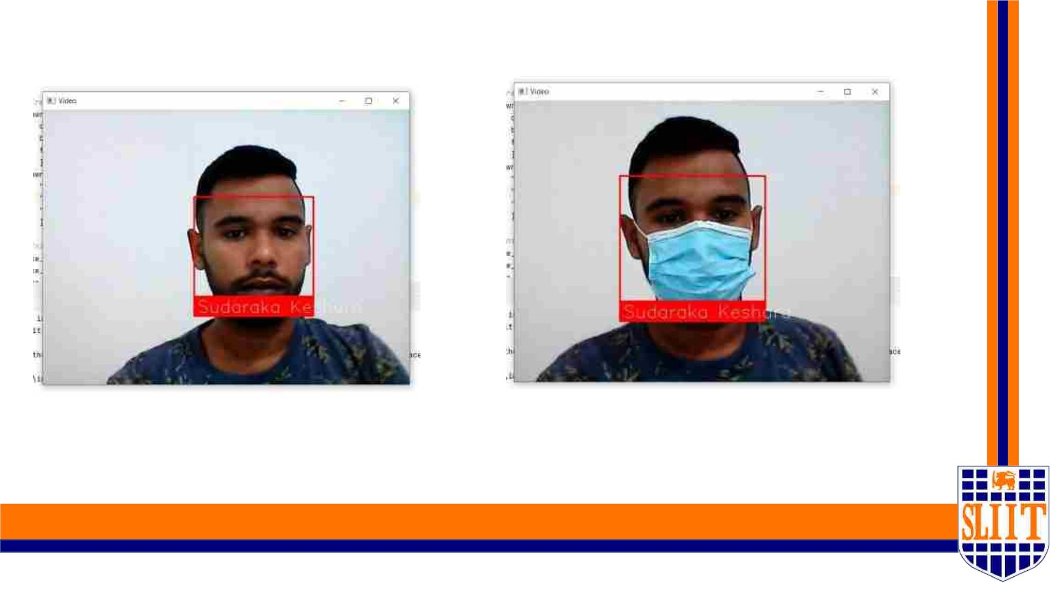
Testing the Model Accuracy
ü Normal face detection scenario
ü Face detection scenario with
facemask
SMART NAVIGATION TOOL FOR VISUALLY IMPAIRED PEOPLE
19
IT19109190 | KESHARA S.R.D.S | 2022-227
19

Slide 20
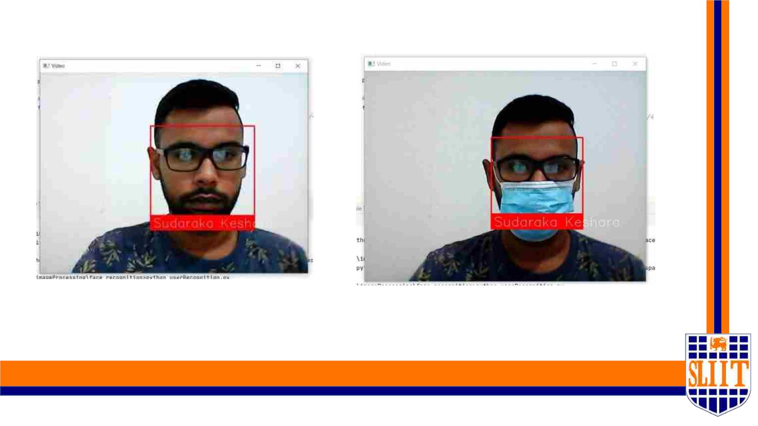
Testing the Model Accuracy
ü Face detection scenario with
spectacles/glasses.
ü Face detection scenario with
facemask + spectacles/glasses.
SMART NAVIGATION TOOL FOR VISUALLY IMPAIRED PEOPLE
20
IT19109190 | KESHARA S.R.D.S | 2022-227
20

Slide 21
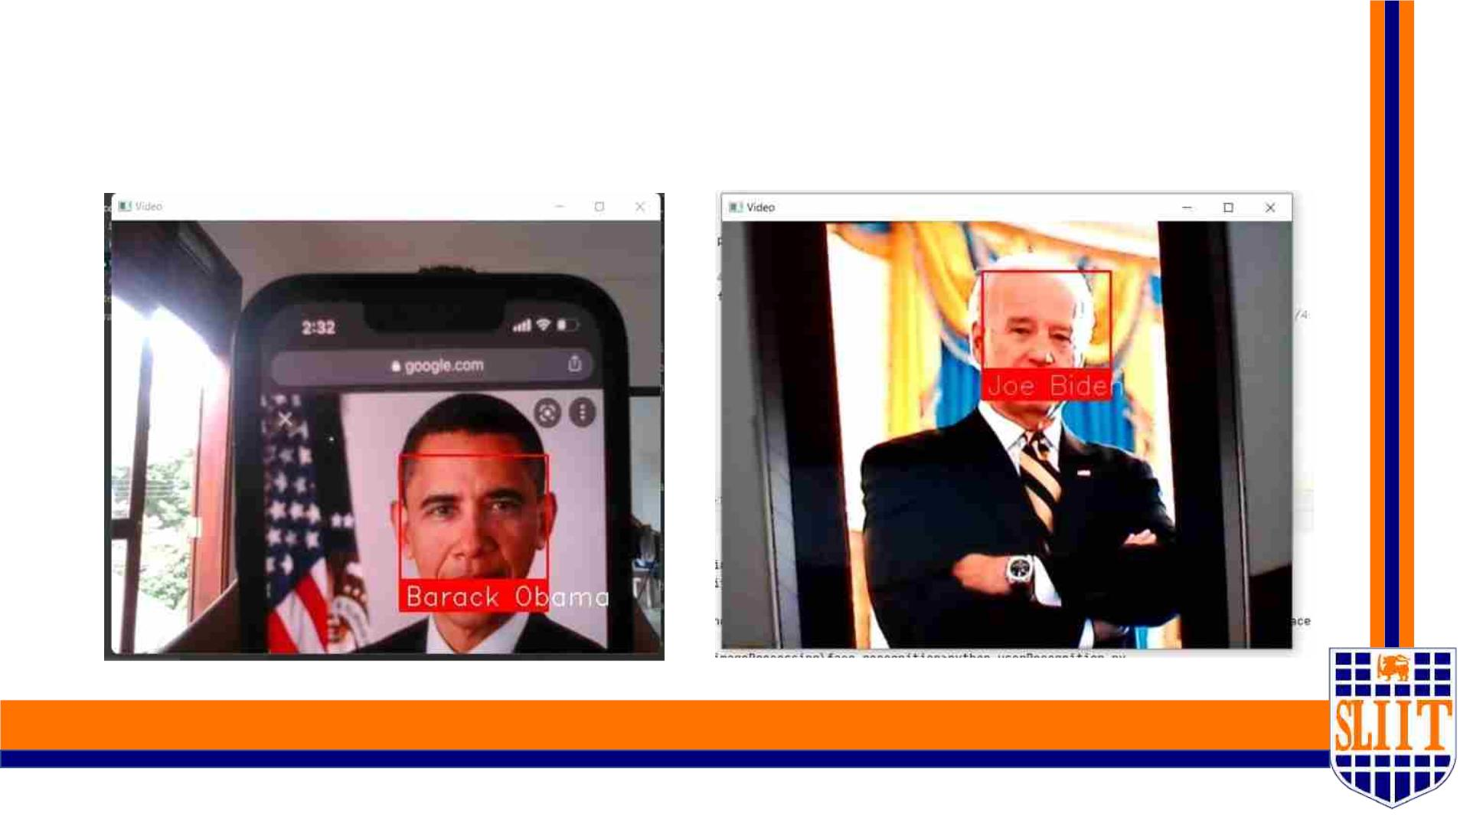
Testing the Model Accuracy
ü Face detection of known individuals.
SMART NAVIGATION TOOL FOR VISUALLY IMPAIRED PEOPLE
21
IT19109190 | KESHARA S.R.D.S | 2022-227
21

Slide 22
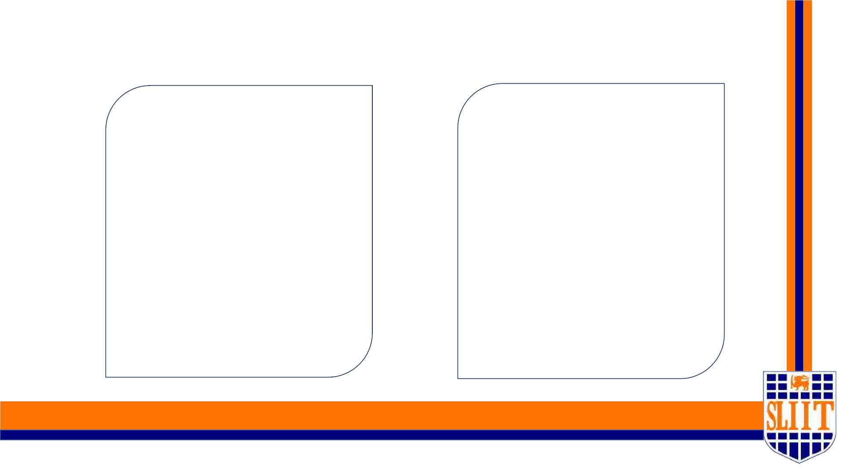
Project completion tasks
Completed work
Work to be completed
o Expand dataset
ü Dataset Collection.
o Multiple angles of person
o Different environments
ü Creating model to identify
individuals.
o Person identification through
voice command.
ü Facial detection using the
Model.
o Distance calculation between
user and known person
SMART NAVIGATION TOOL FOR VISUALLY IMPAIRED PEOPLE
22
IT19109190 | KESHARA S.R.D.S | 2022-227
22

Slide 23

TECHNOLOGIES USED AND TO BE USED
• Python
• PyCharm / VSCode
• Firebase
• OpenCV
SMART NAVIGATION TOOL FOR VISUALLY IMPAIRED PEOPLE
23
IT19109190 | KESHARA S.R.D.S | 2022-227
23

Slide 24

WORK BREAKDOWN STRUCTURE
SMART NAVIGATION TOOL FOR VISUALLY IMPAIRED PEOPLE
24
IT19109190 | KESHARA S.R.D.S | 2022-227
24

Slide 25
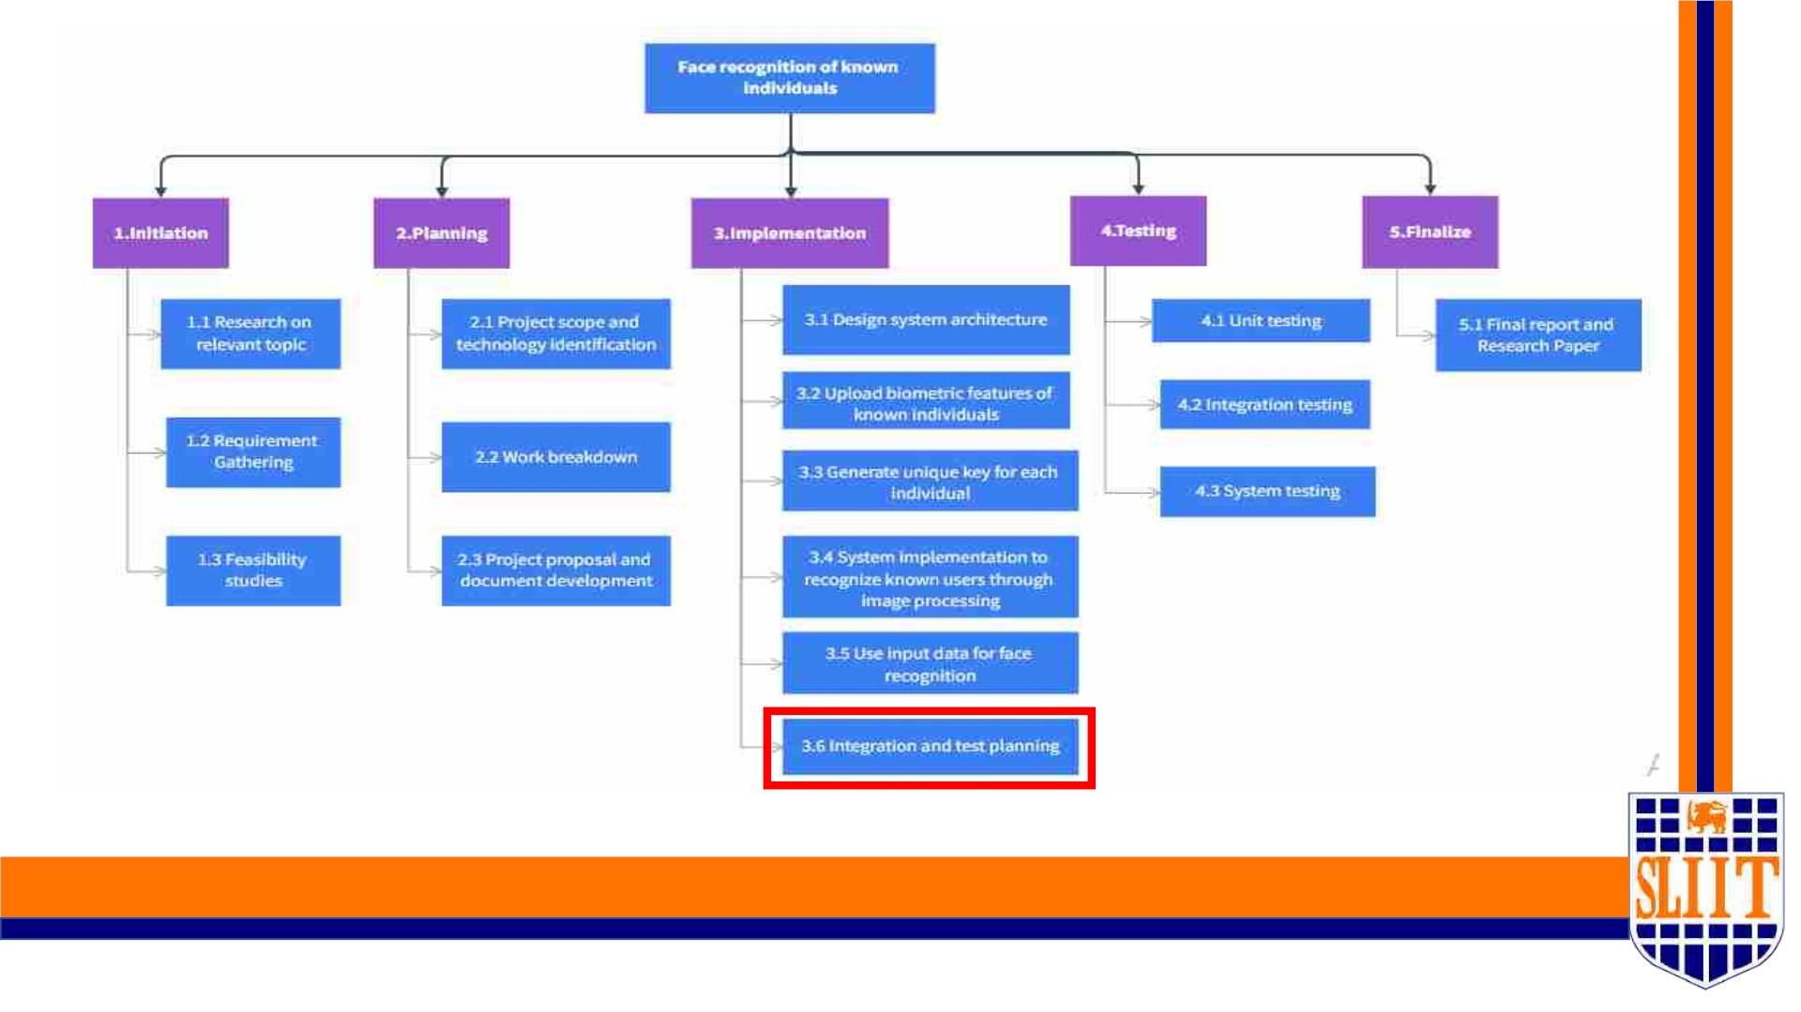
SMART NEVIGATION TOOL FOR VISUALLY IMPAIRED PEOPLE
25
IT19109190 | KESHARA S.R.D.S | 2022-227
25

Slide 26

GANTT CHART
SMART NAVIGATION TOOL FOR VISUALLY IMPAIRED PEOPLE
26
IT19109190 | KESHARA S.R.D.S | 2022-227
26

Slide 27
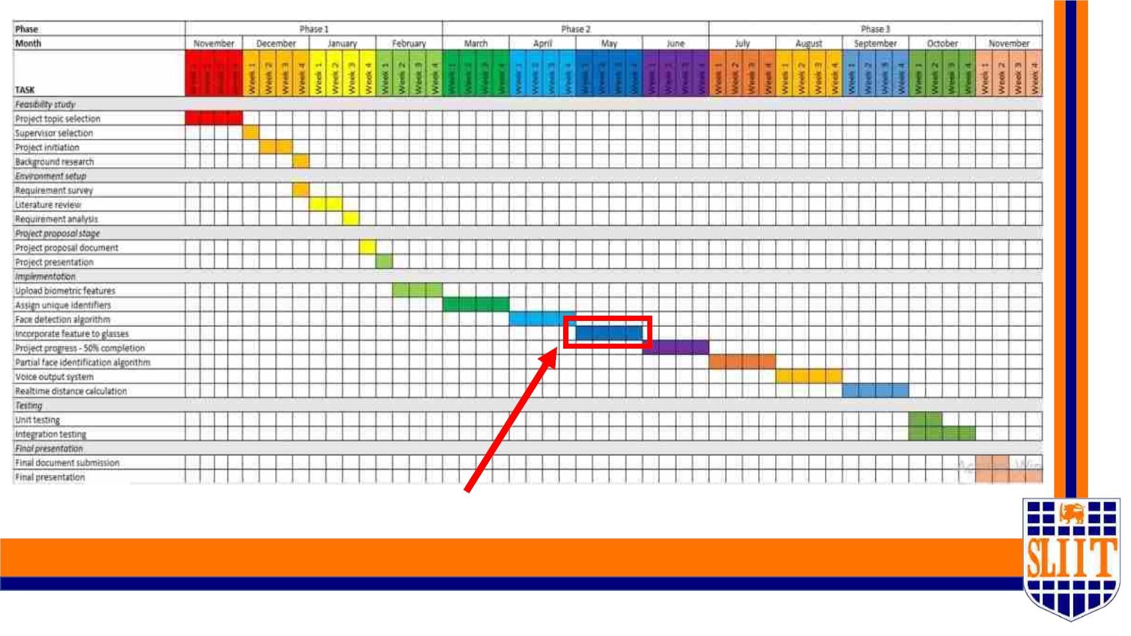
Current progress
SMART NAVIGATION TOOL FOR VISUALLY IMPAIRED PEOPLE
27
IT19109190 | KESHARA S.R.D.S | 2022-227
27

Slide 28
vReferences
1)Balakrishnan G, Sainarayanan G, Nagarajan R and Yaacob S. 2007. Wearable Real-Time
Stereo Vision for the Visually Impaired Engineering. [1]
2)Sharma, Saransh, and Samyak Jain. "A static hand gesture and face recognition system for
blind people." 2019 6th International Conference on Signal Processing and Integrated Networks
(SPIN). IEEE, 2019. [2]
3)K. M. Kramer, D. S. Hedin and D. J. Rolkosky, "Smartphone based face recognition tool for the
blind," 2010 Annual International Conference of the IEEE Engineering in Medicine and Biology,
2010. [3]
4)R. Agarwal et al., "Low cost ultrasonic smart glasses for blind," 2017 8th IEEE Annual
Information Technology, Electronics and Mobile Communication Conference (IEMCON), 2017 [4]
5)M. Awad, J. E. Haddad, E. Khneisser, T. Mahmoud, E. Yaacoub and M. Malli, "Intelligent eye: A
mobile application for assisting blind people," 2018 IEEE Middle East and North Africa
Communications Conference (MENACOMM), 2018. [5]
6)L. Albraheem et al., "Third Eye: An Eye for the Blind to Identify Objects Using Human-
Powered Technology," 2015 International Conference on Cloud Computing (ICCC), 2015. [6]
SMART NAVIGATION TOOL FOR VISUALLY IMPAIRED PEOPLE
28
IT19109190 | KESHARA S.R.D.S | 2022-227
28

Slide 29
SMART NAVIGATION TOOL FOR VISUALLY IMPAIRED PEOPLE
28
IT19109190 | KESHARA S.R.D.S | 2022-227
29

Slide 30

IT19042152 | MADUSHAN W. A.
SPECIALIZATION : SE
SMART NAVIGATION TOOL FOR VISUALLY IMPAIRED PEOPLE
60
IT19042152 | W A Madushan | 2022-227
30

Slide 31
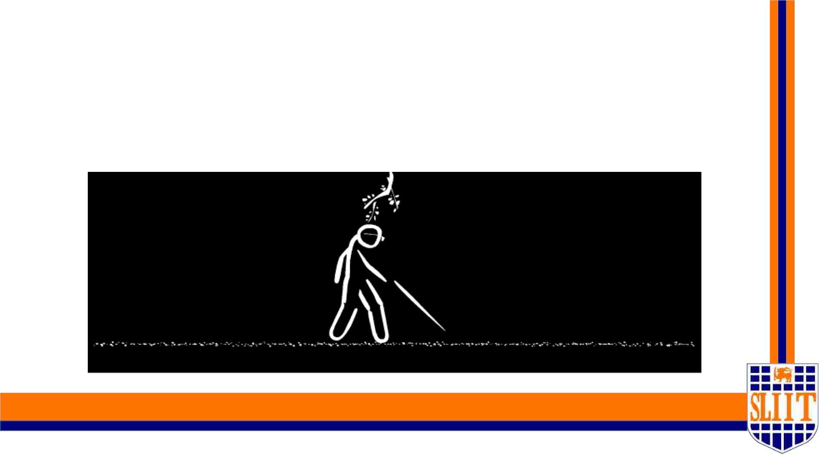
OBSTACLE DETECTION FOR SAFE
NAVIGATION
SMART NAVIGATION TOOL FOR VISUALLY IMPAIRED PEOPLE
61
IT19042152 | W A Madushan | 2022-227
31

Slide 32

RESEARCH QUESTION
• Globally, at least 2.2 billion people have a near or distance vision impairment.
• Many of these persons use the white cane – the most successful and widely used
travel aid for the blind.
• This purely mechanical device is used to detect obstacles on the ground, uneven
surfaces, holes, steps, and other hazards.
SMART NAVIGATION TOOL FOR VISUALLY IMPAIRED PEOPLE
62
IT19042152 | W A Madushan | 2022-227
32

Slide 33

RESEARCH QUESTION (CONT..)
• The main problem with this device is that users must be trained in its use for
more than 100 hours – a substantial “hidden” cost.
• In addition, the white cane requires the user to actively scan the small area
ahead of them. They have to touch everything using the cane to get an idea
about them.
• Detecting potholes using a cane also not a convenient task.
SMART NAVIGATION TOOL FOR VISUALLY IMPAIRED PEOPLE
63
IT19042152 | W A Madushan | 2022-227
33

Slide 34

MAIN OBJECTIVE
Recognize obstacles ,walking surface and pothole using the camera and
smart cane to provide appropriate information through audio and
signal for safe navigation.
SMART NAVIGATION TOOL FOR VISUALLY IMPAIRED PEOPLE
64
IT19042152 | W A Madushan | 2022-227
34

Slide 35
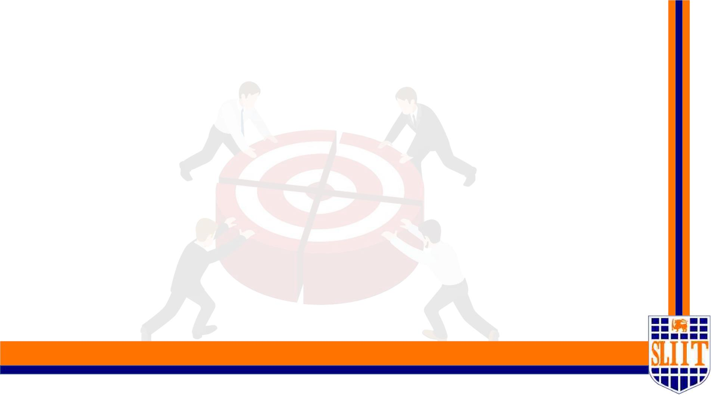
SPECIFIC OBJECTIVES
•Detect obstacles in user path – Smart Cane plugin.
•Detect walking surface – Smart Glass.
•Design and train a models to identify pothole according to inputs.
•Design and train a models to identify surface behavior according to inputs.
•Design a smart cane to identify the obstacles(IOT part).
•Impalement a vocal instruction system.
SMART NAVIGATION TOOL FOR VISUALLY IMPAIRED PEOPLE
65
IT19042152 | W A Madushan | 2022-227
35

Slide 36

RESEARCH METHODOLOGY
SMART NAVIGATION TOOL FOR VISUALLY IMPAIRED PEOPLE
66
IT19042152 | W A Madushan | 2022-227
36

Slide 37
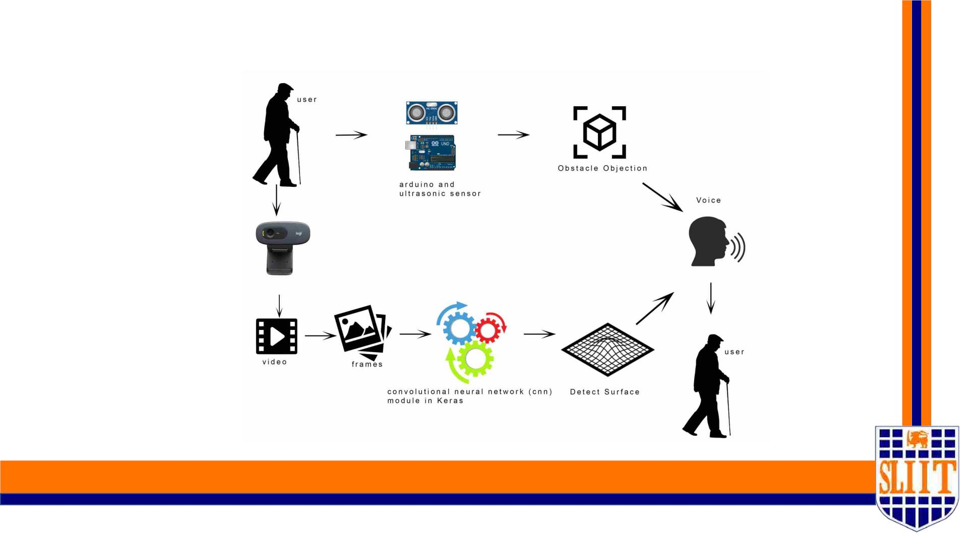
System Diagram
SMART NAVIGATION TOOL FOR VISUALLY IMPAIRED PEOPLE
67
IT19042152 | W A Madushan | 2022-227
37

Slide 38
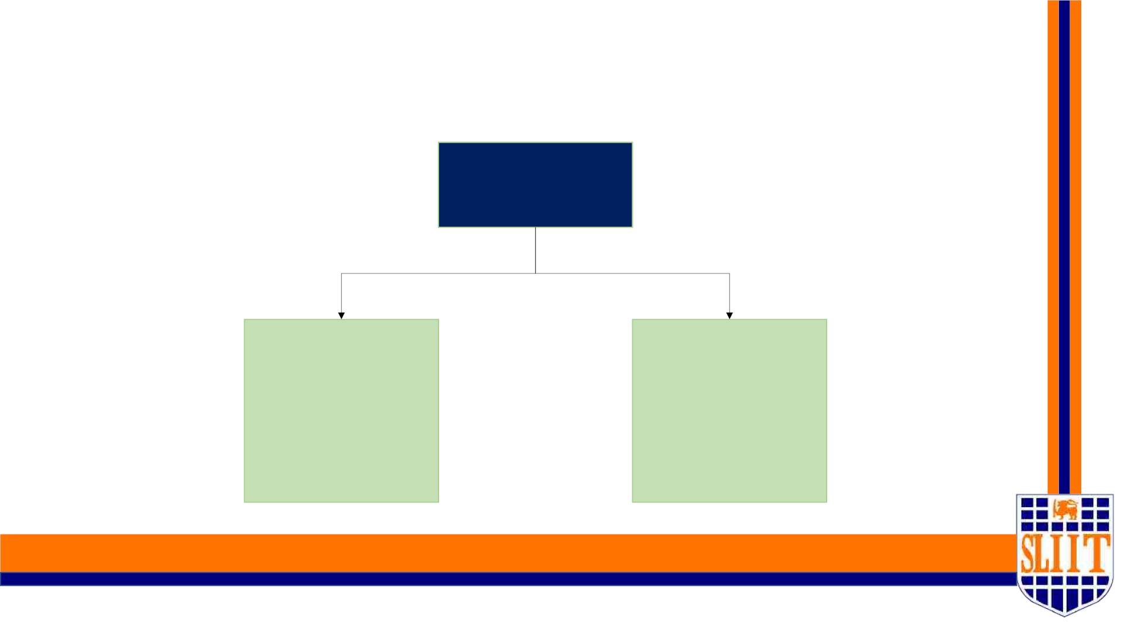
METHODOLOGY
Component
Smart cane (detect
obstacles)
Surface Detection
and pothole
Detection
SMART NAVIGATION TOOL FOR VISUALLY IMPAIRED PEOPLE
68
IT19042152 | W A Madushan | 2022-227
38

Slide 39

ART CANE PLUGIN
SMART NAVIGATION TOOL FOR VISUALLY IMPAIRED PEOPLE
69
IT19042152 | W A Madushan | 2022-227
39

Slide 40

Why I have designed a Smart cane
1. Obstacle detection using IUP is an impractical thing
• When it comes to real time there will be a time gap between processing time. So , it
will be a negative impact for system.
2. The white cane is inevitable thing for people who are visually
impaired or blind.
SMART NAVIGATION TOOL FOR VISUALLY IMPAIRED PEOPLE
70
IT19042152 | W A Madushan | 2022-227
40

Slide 41
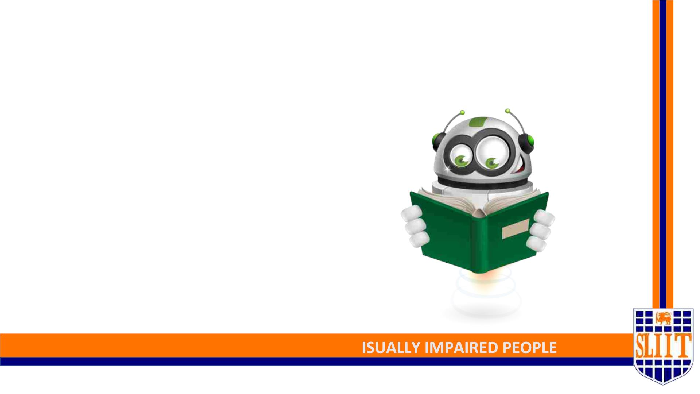
Features of smart cane plugin
• 2m obstacle detection coverage
• Fast response time
• Automatic lighting system
• Easy to setup (Plugin device)
SMART NAVIGATION TOOL FOR V
71
IT19042152 | W A Madushan | 2022-227
41

Slide 42
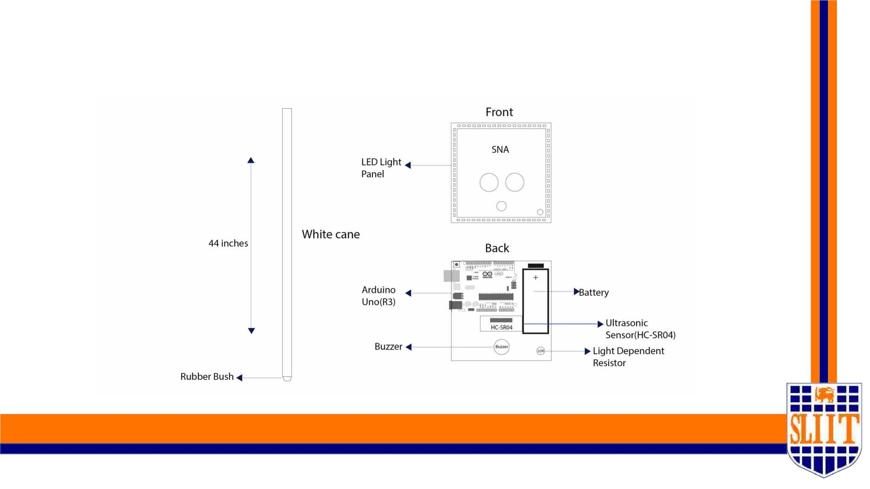
Blueprint of smart cane plugin
SMART NAVIGATION TOOL FOR VISUALLY IMPAIRED PEOPLE
72
IT19042152 | W A Madushan | 2022-227
42

Slide 43
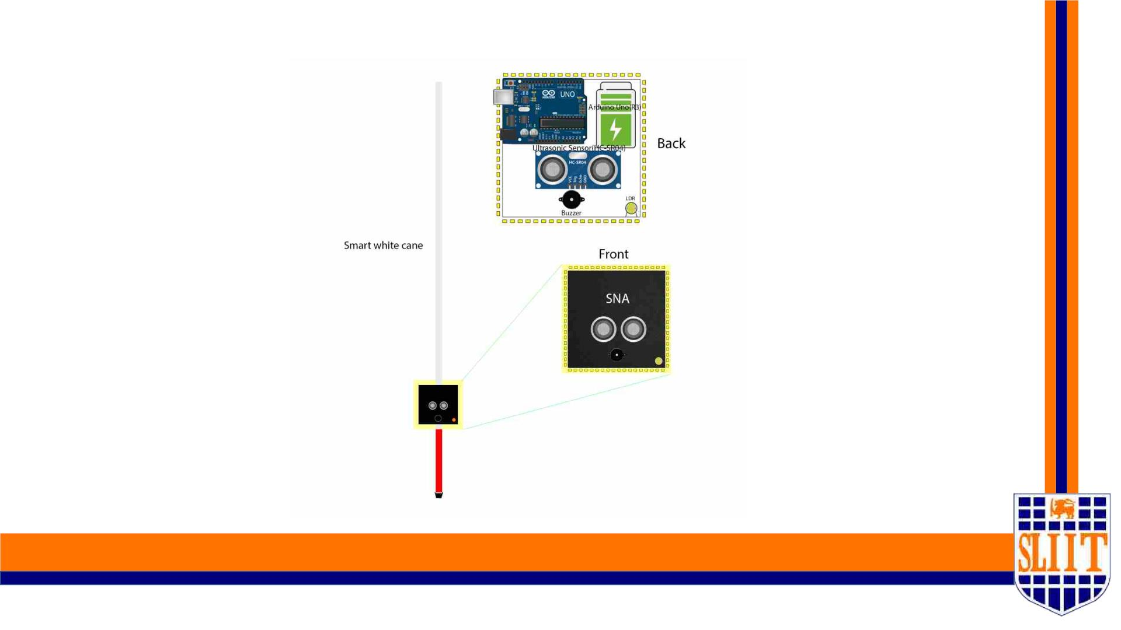
Prototype
SMART NAVIGATION TOOL FOR VISUALLY IMPAIRED PEOPLE
73
IT19042152 | W A Madushan | 2022-227
43

Slide 44
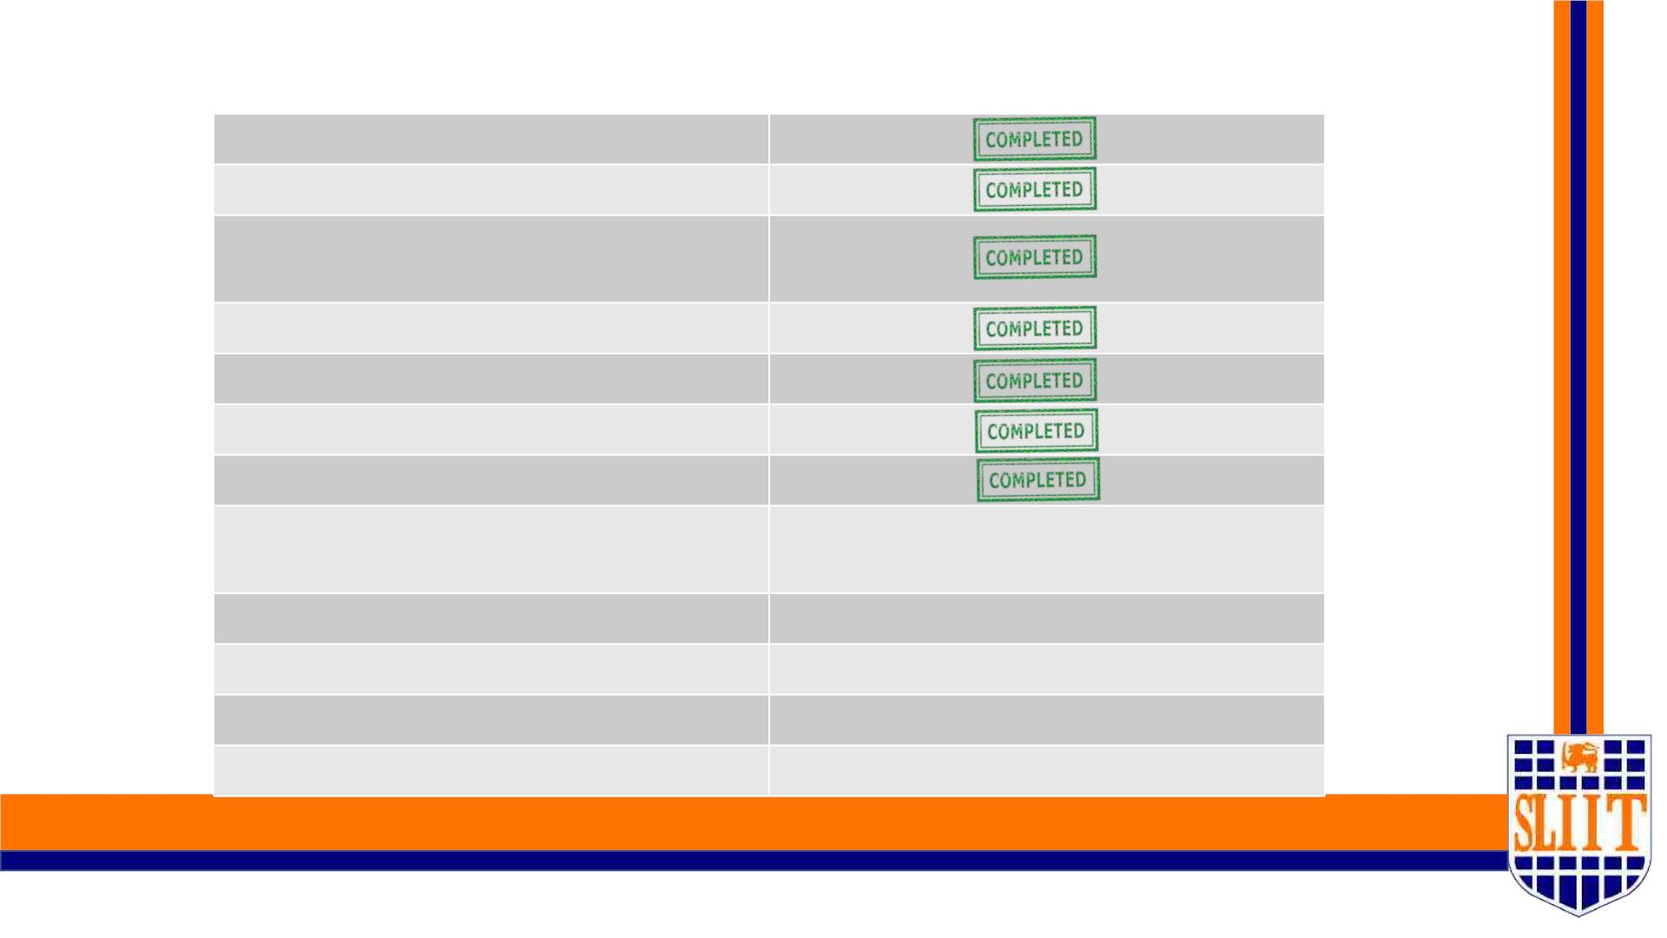
Competition of Smart cane plugin - 60%
Draw the blueprint of the plugin
Draw the prototype
Implement Arduino code and ultrasonic
sensor
Implement the buzzer
Testing phase 01
Demo assembling
Testing phase 02
Implement LDR sensor and lighting
system
NOT COMPLETED
NOT COMPLETED
Final assembling
Testing phase 03
User Testing
NOT COMPLETED
NOT COMPLETED
NOT COMPLETED
Final release
SMART NAVIGATION TOOL FOR VISUALLY IMPAIRED PEOPLE
74
IT19042152 | W A Madushan | 2022-227
44

Slide 45
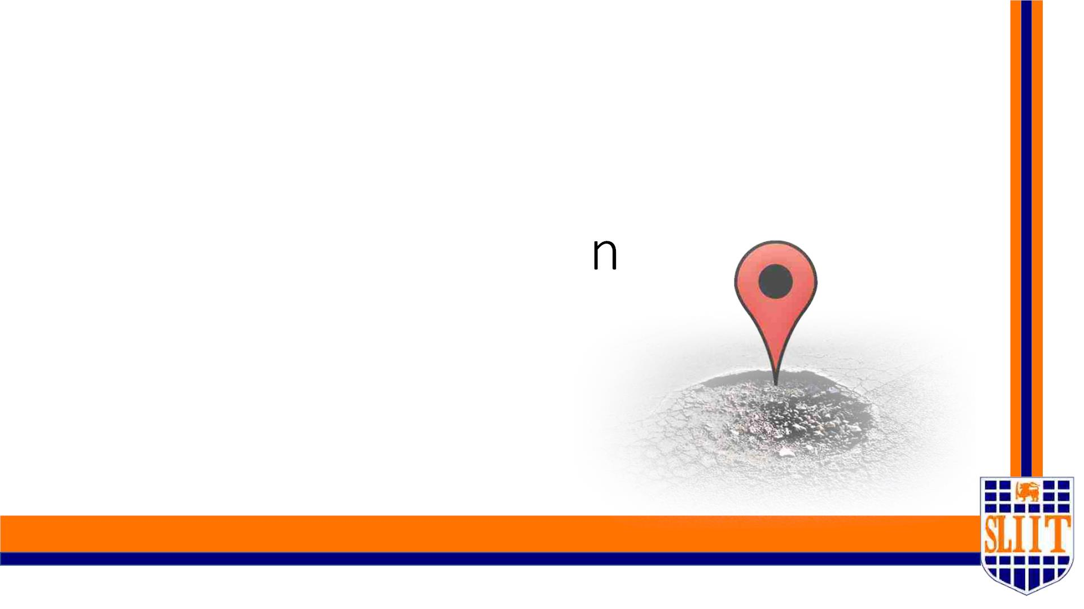
Surface Detection & Pothole
Detectio
SMART NAVIGATION TOOL FOR VISUALLY IMPAIRED PEOPLE
75
IT19042152 | W A Madushan | 2022-227
45

Slide 46

Methodology Major phases
A. Data preparation
B. Train model on data
C. Analysis/Evolution Model
D. Detect pothole and surface from inputs
E. Voice command implementation
SMART NAVIGATION TOOL FOR VISUALLY IMPAIRED PEOPLE
76
IT19042152 | W A Madushan | 2022-227
46

Slide 47
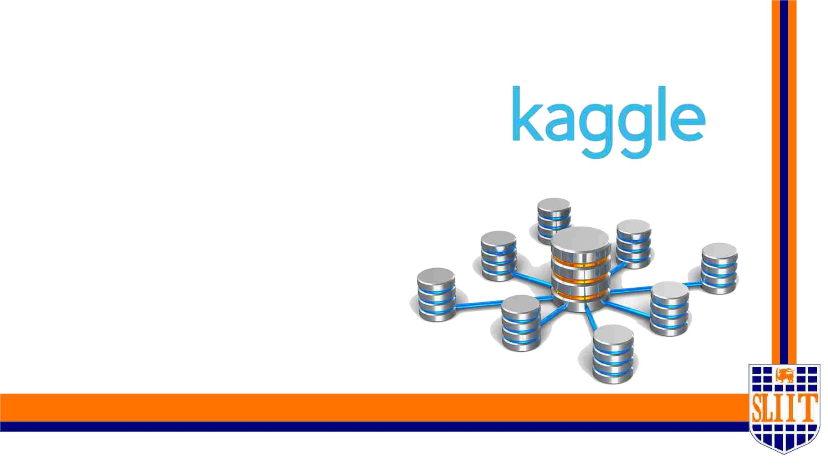
A. Data preparation
I. Collecting data
1. kaggle.com and customer dataset
II. Data preprocessing
III. Data splitting
SMART NAVIGATION TOOL FOR VISUALLY IMPAIRED PEOPLE
77
IT19042152 | W A Madushan | 2022-227
47

Slide 48

B. Train And Testing Model On Data
I. Faster training speeding and higher efficiency
II. Lower memory usage
III. Better accuracy
IV. Capable of handling large-scale data
SMART NAVIGATION TOOL FOR VISUALLY IMPAIRED PEOPLE
78
IT19042152 | W A Madushan | 2022-227
48

Slide 49
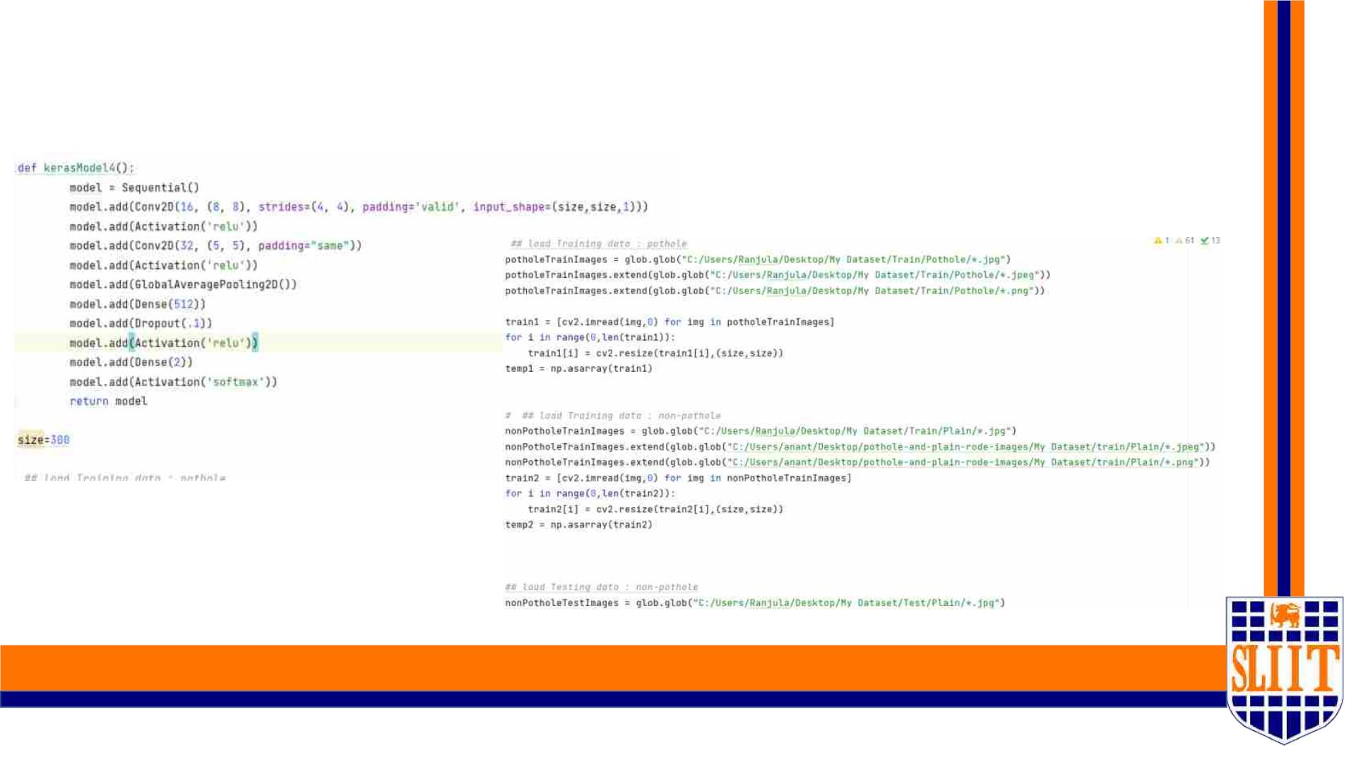
B. Train And Testing Model On Data
SMART NAVIGATION TOOL FOR VISUALLY IMPAIRED PEOPLE
79
IT19042152 | W A Madushan | 2022-227
49

Slide 50
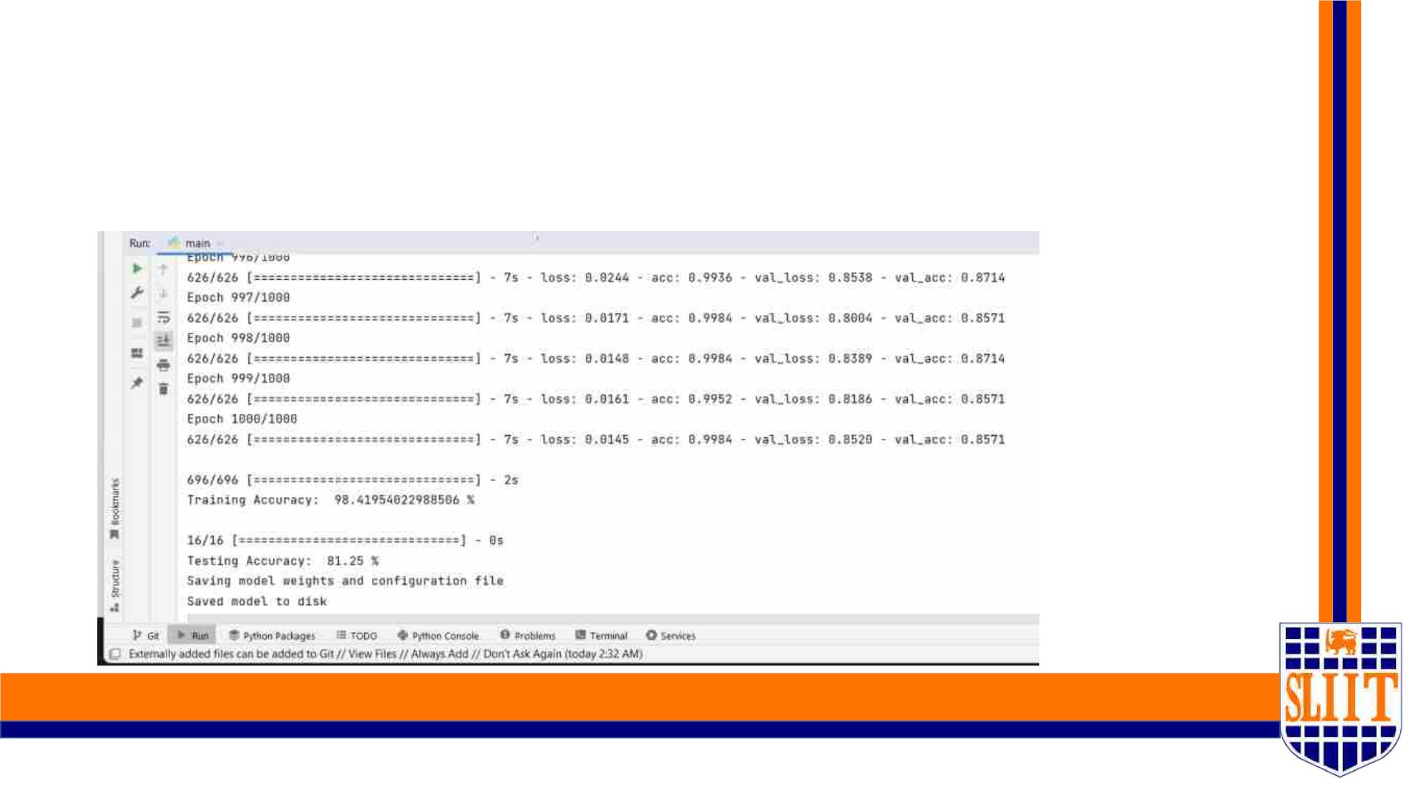
C. Accuracy of Pothole detection model
Training Accuracy :- 98.41% and Testing Accuracy :- 81.25%
SMART NAVIGATION TOOL FOR VISUALLY IMPAIRED PEOPLE
80
IT19042152 | W A Madushan | 2022-227
50

Slide 51
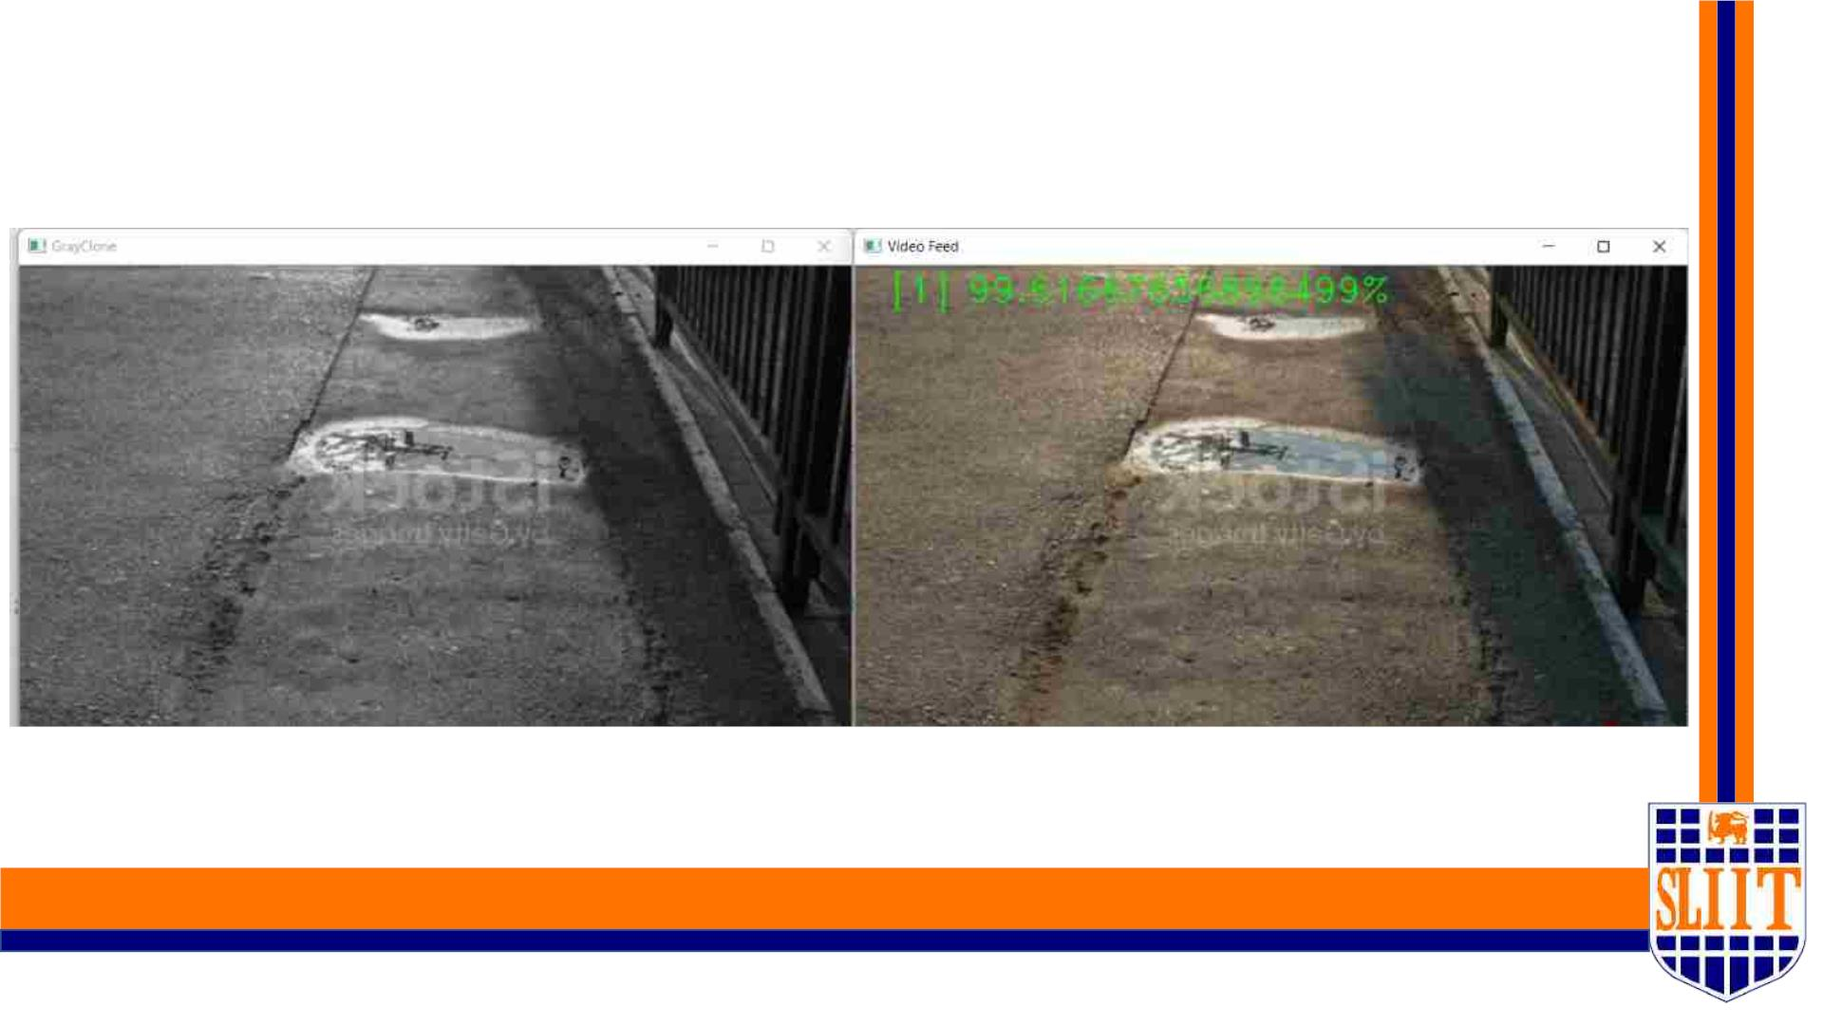
C. Output of Model
SMART NAVIGATION TOOL FOR VISUALLY IMPAIRED PEOPLE
81
IT19042152 | W A Madushan | 2022-227
51

Slide 52

Technologies to be used
• Python (version 3.8)
• OpenCV
• Keras
• Tensorflow
• Numpy/Matplotlib
• H5py
• Pillow
• Git
• Pycharm
SMART NAVIGATION TOOL FOR VISUALLY IMPAIRED PEOPLE
82
IT19042152 | W A Madushan | 2022-227
52

Slide 53
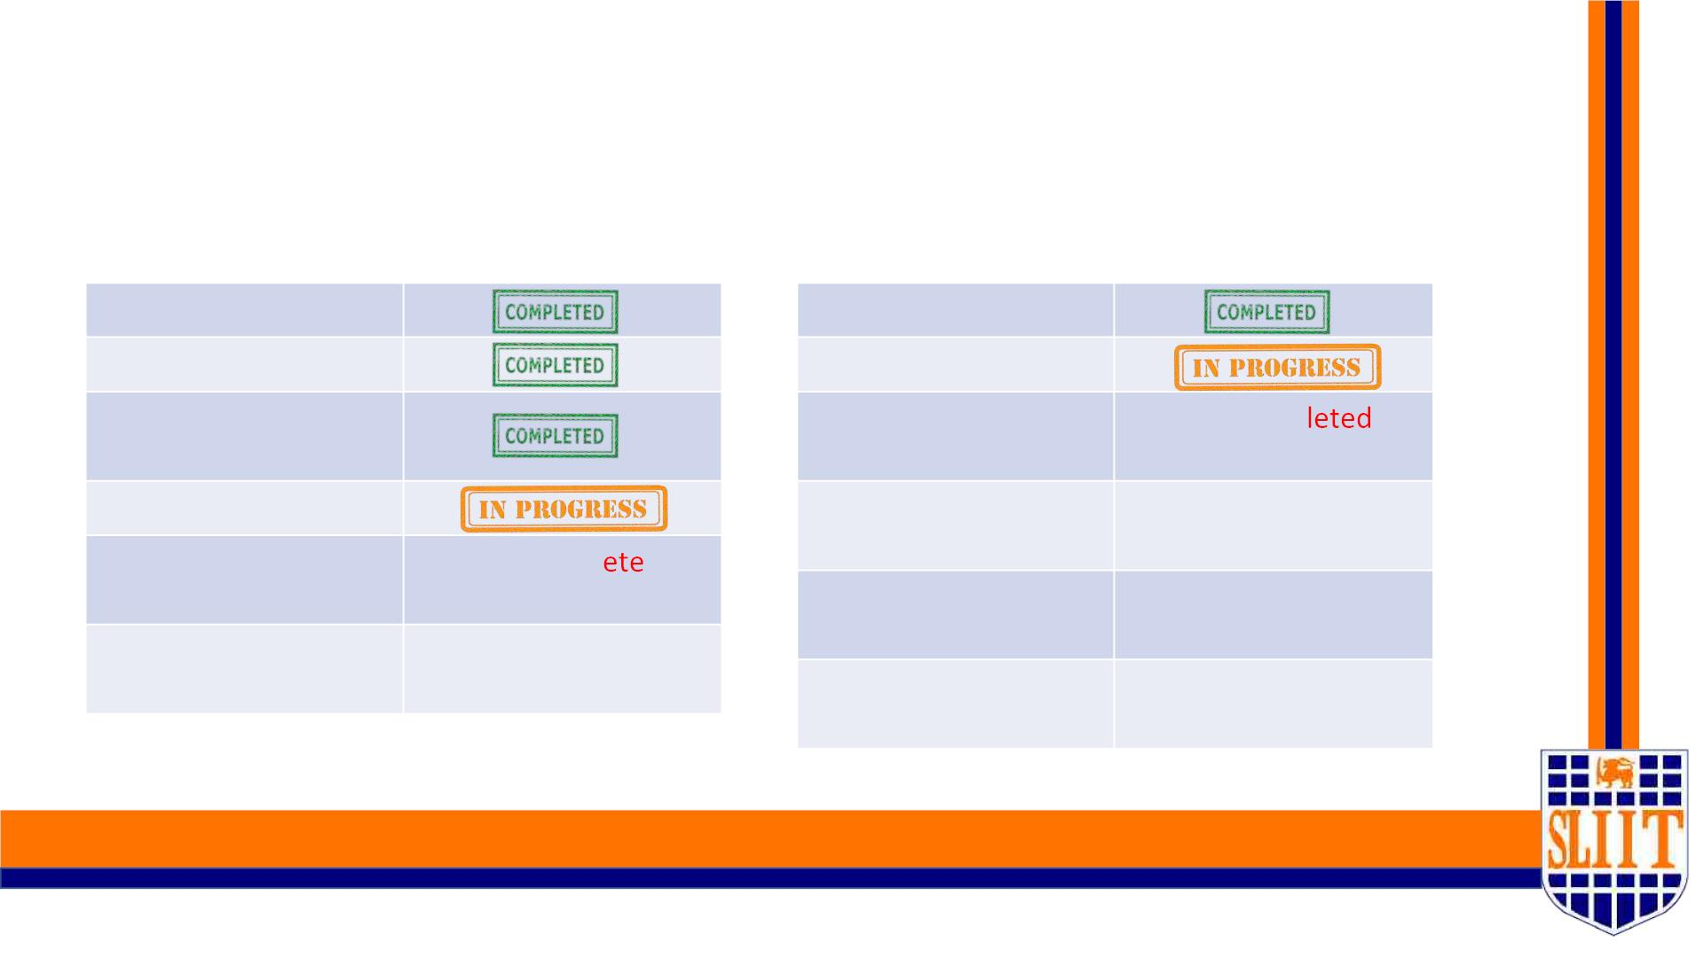
Completion of surface and pothole detection - 40%
Pothole detection
Dataset preparing
Surface detection
Dataset preparing
Train and test model
Train and test model
Test phase 1(check
accuracy )
Test phase 1(check
accuracy )
Not Comp
Improve the accuracy
Improve the accuracy
Not Completed
Not Completed
Not Completed
Implement vocal
command
Not Compl d
Not Completed
Implement vocal
command
User Testing
User Testing
SMART NAVIGATION TOOL FOR VISUALLY IMPAIRED PEOPLE
83
IT19042152 | W A Madushan | 2022-227
53

Slide 54
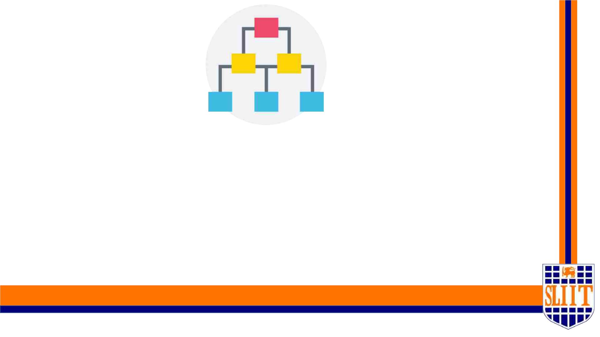
WORK BREAKDOWN STRUCTURE
SMART NAVIGATION TOOL FOR VISUALLY IMPAIRED PEOPLE
84
IT19042152 | W A Madushan | 2022-227
54

Slide 55
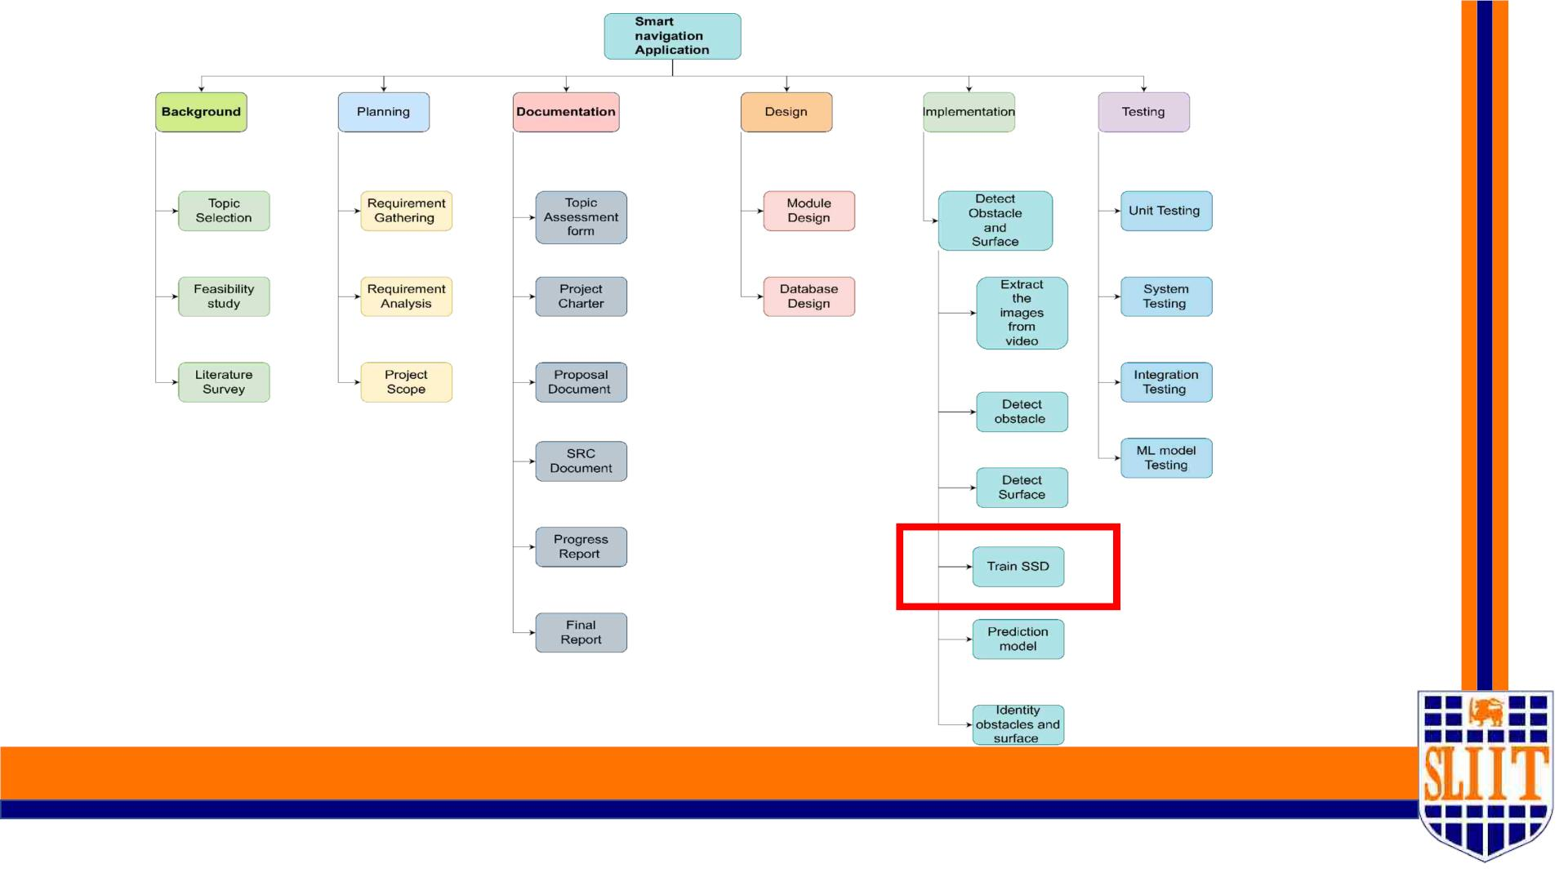
SMART NAVIGATION TOOL FOR VISUALLY IMPAIRED PEOPLE
85
IT19042152 | W A Madushan | 2022-227
55

Slide 56
GANTT PROCESS CHART
SMART NAVIGATION TOOL FOR VISUALLY IMPAIRED PEOPLE
86
IT19042152 | W A Madushan | 2022-227
56

Slide 57
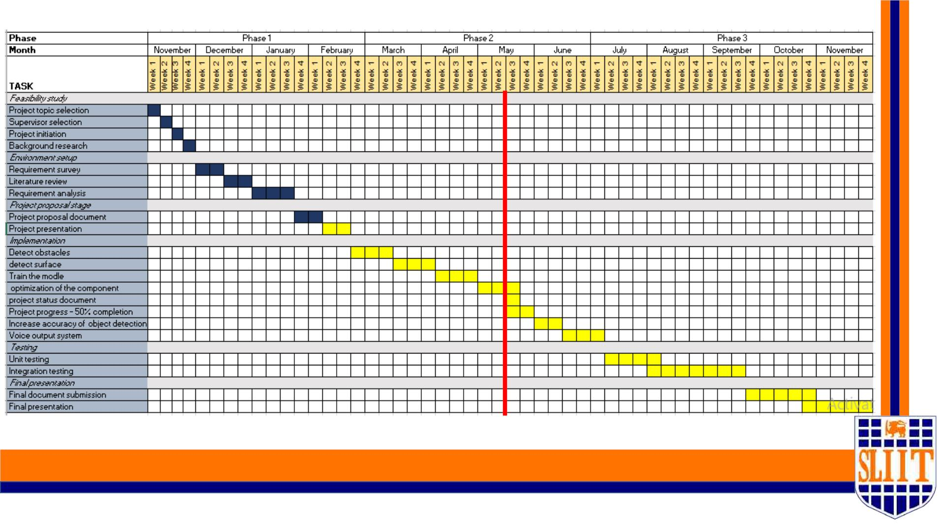
SMART NAVIGATION TOOL FOR VISUALLY IMPAIRED PEOPLE
87
IT19042152 | W A Madushan | 2022-227
57

Slide 58

REFERENCES
SMART NAVIGATION TOOL FOR VISUALLY IMPAIRED PEOPLE
88
IT19042152 | W A Madushan | 2022-227
58

Slide 59
• [1] H. Jabnoun, F. Benzarti and H. Amiri, "Object detection and identification for blind people in video scene," 2015 15th International Conference on
Intelligent Systems Design and Applications (ISDA), 2015, pp. 363-367, doi: 10.1109/ISDA.2015.7489256.
• [2] Object Detection for Blind User’s Pooja Maid1, Omkar Thorat2, Sarita Deshpande3 Student, Dept. of Information Technology Engineering, P.E.S’s
Modern College of Engineering Pune,Maharashtra, India
• [3] R. Kedia et al., "MAVI: Mobility Assistant for Visually Impaired with Optional Use of Local and Cloud Resources," 2019 32nd International Conference
on VLSI Design and 2019 18th International Conference on Embedded Systems (VLSID), 2019, pp. 227-232, doi: 10.1109/VLSID.2019.00058.
• [4] Blind Assist: Project Proposal Oluwaseyitan Joshua Durodola Nathaniel Sims Chris Uruquhart
• [5] Yashas, M., Maalik, K.S., M.Z.M., A., & K.P.S.H.,D.S. (2017). Blind Guider: An IT Solution for Visually Impaired People. International journal of scientific
and research publications, 7.
• [8] P. Meijer, “An Experimental System for Auditory Image Representations,” IEEE Transactions on Biomedical Engineering, vol. 39, no 2, pp. 112-121, Feb
1991.
• [9] G. Sainarayanan, “On Intelligent Image Processing Methodologies Applied to Navigation Assistance for Visually Impaired”, Ph. D. Thesis, University
Malaysia Sabah, 2002.
• [10] . Balakrishnan, G. Sainarayanan, R. Nagarajan and S. Yaacob, “Wearable Real-Time Stereo Vision for the Visually Impaired,” Engineering Letters, vol.
14, no. 2, 2007.
• [11] G. P. Fajarnes, L. Dunai, V. S. Praderas and I. Dunai, “CASBLiP- a new cognitive object detection and orientation system for impaired people,”
Proceedings of the 4th International Conference on Cognitive Systems, ETH Zurich, Switzerland, 2010.
SMART NAVIGATION TOOL FOR VISUALLY IMPAIRED PEOPLE
89
IT19042152 | W A Madushan | 2022-227
59

Slide 60
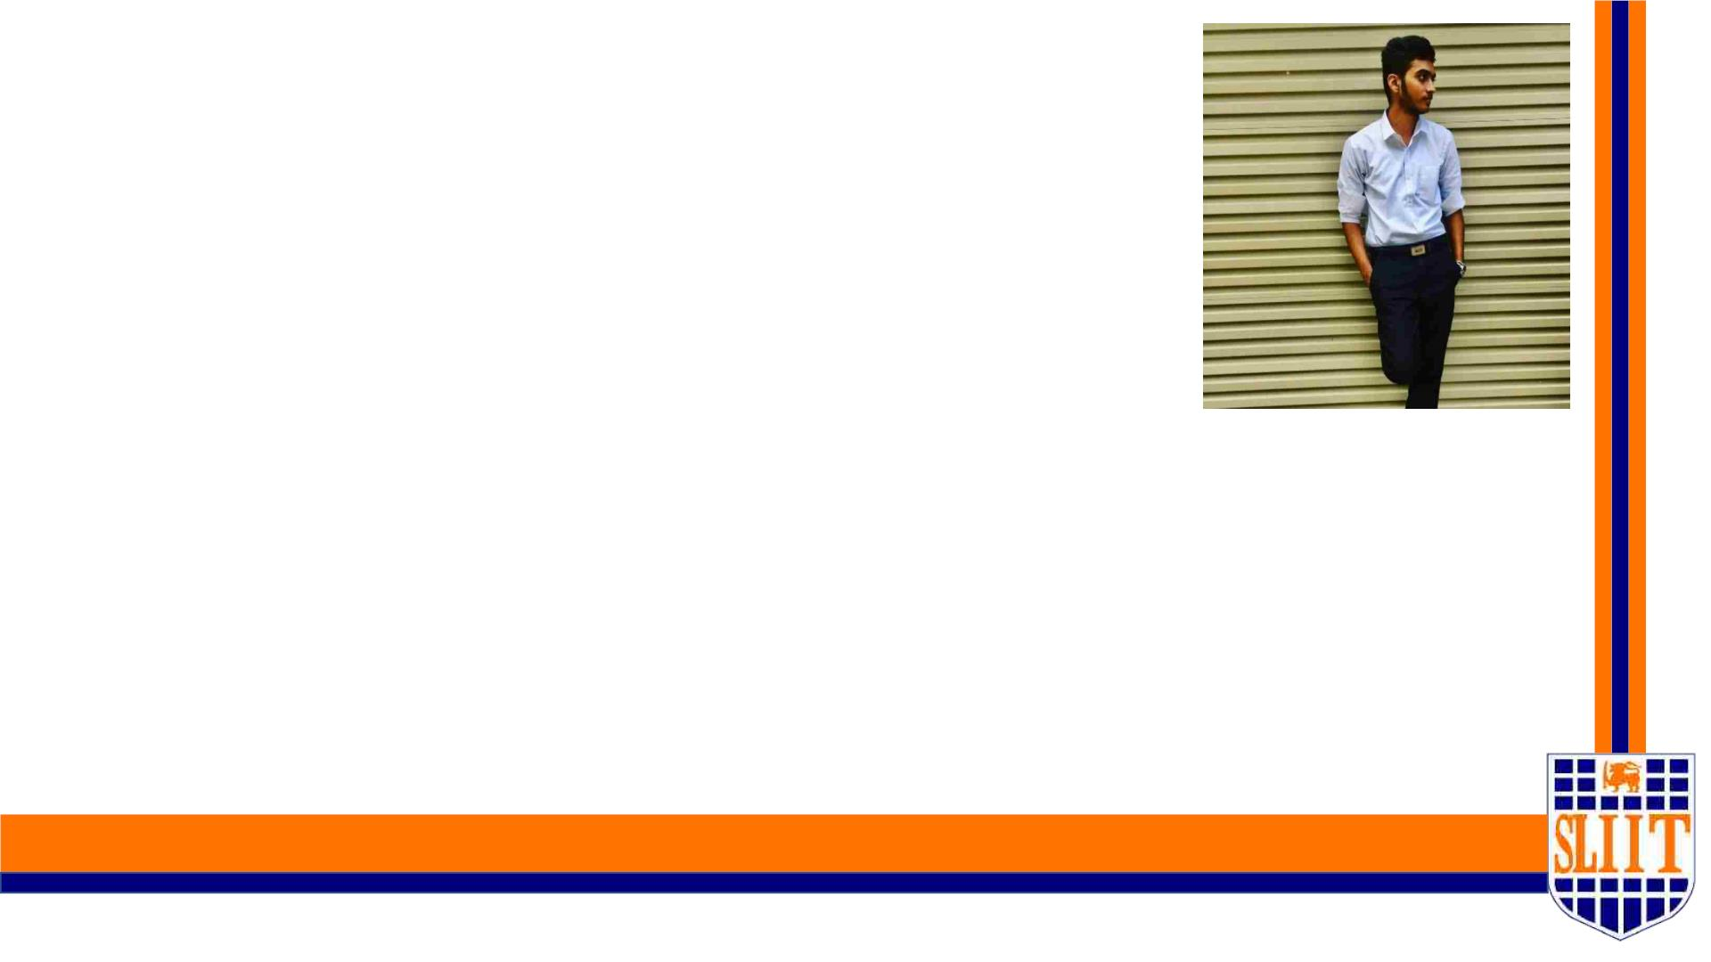
IT19049878| Jathusanan .e
SPECIALIZATION : SE
SMART NAVIGATION TOOL FOR VISUALLY IMPAIRED PEOPLE
90
IT19049878 | Jathusanan.E | 2022-227
60

Slide 61
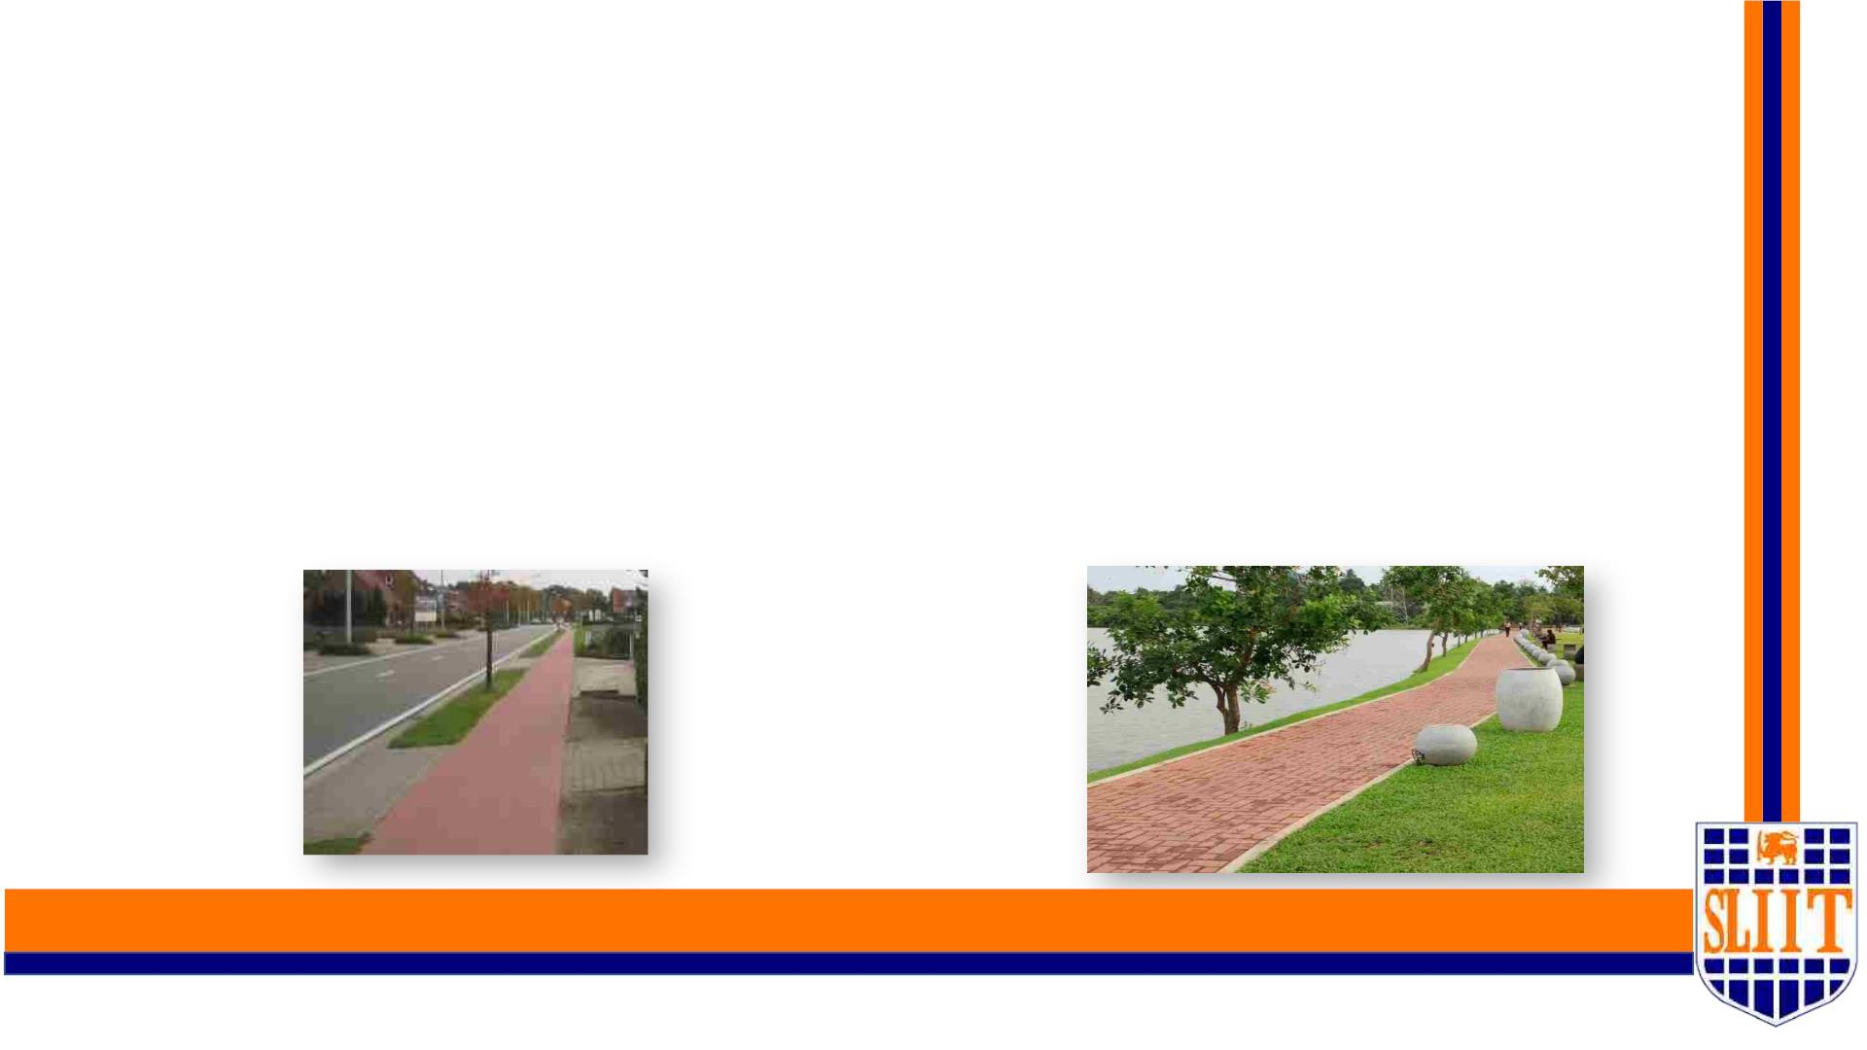
v Introduction
What are walk-lanes ?
• Walk-lanes are the lane like structure which is placed in the both sides of a main roads.
• In Sri Lanka, walk-lanes can be seen more often in most places.
• It is a challenge for a visually challenged person to find the walk-lanes and navigate through
the walk-lanes.
SMART NAVIGATION TOOL FOR VISUALLY IMPAIRED PEOPLE
91
IT19049878 | Jathusanan.E | 2022-227
61

Slide 62
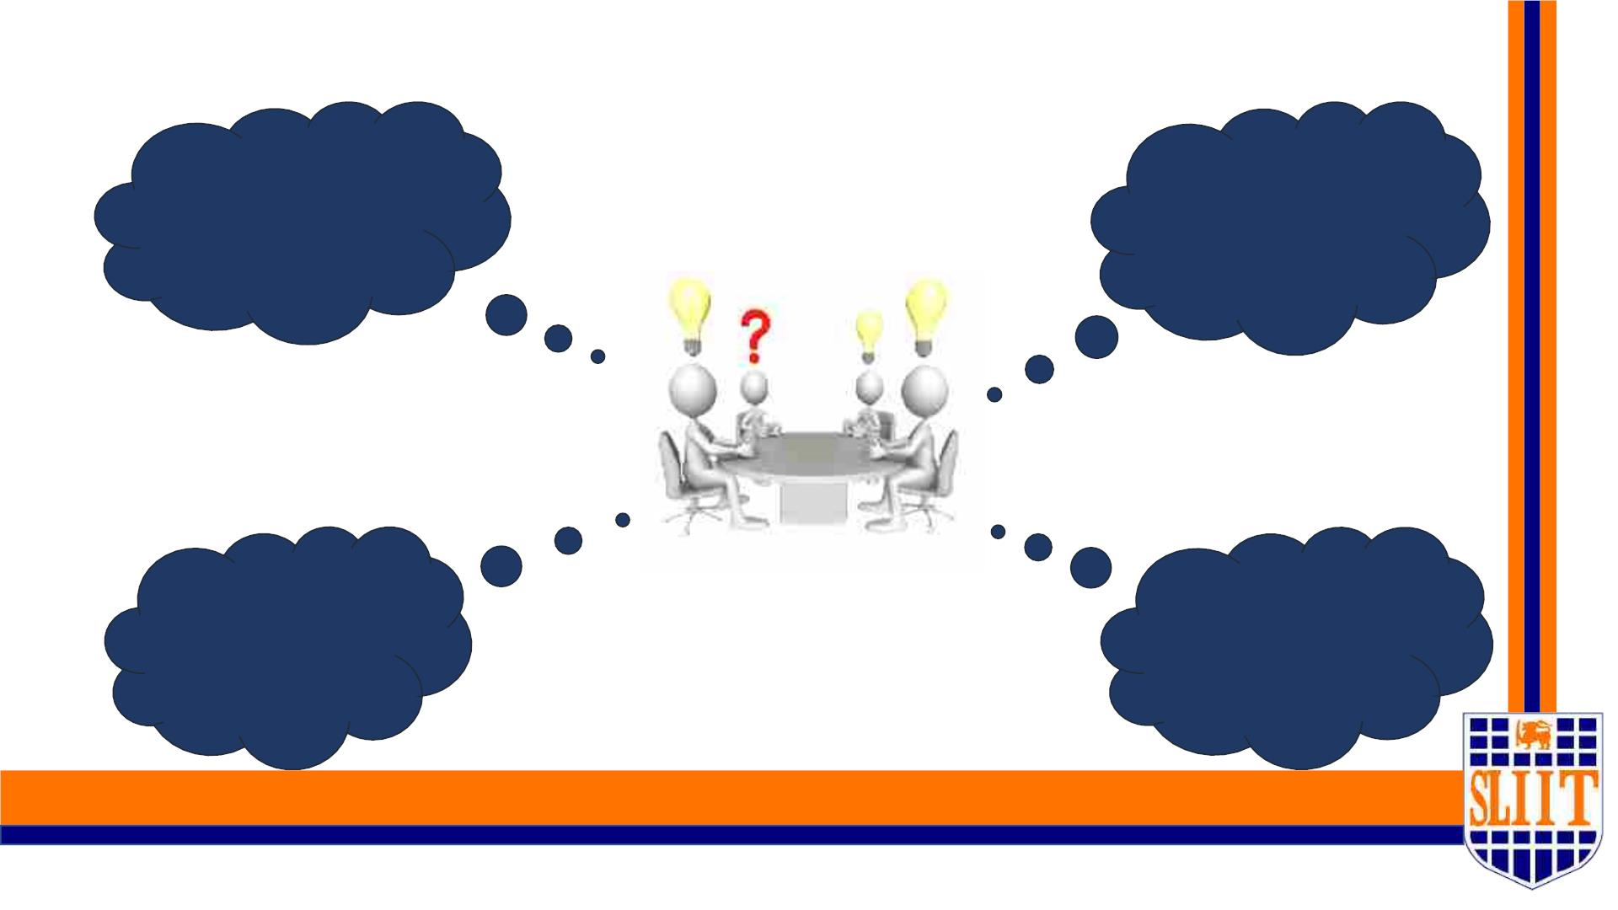
v Research Questions
How to gather the
dataset in this
pandemic situation ?
How often do visually
impaired person fail to
identify the walk-lanes
?
taset g e n in
d
a
o
How to provide a good
solution when travelling
through the walk-lanes ?
Do they able to
utilize our system ?
SMART NAVIGATION TOOL FOR VISUALLY IMPAIRED PEOPLE
92
IT19049878 | Jathusanan.E | 2022-227
62

Slide 63

v Specific and Sub Objectives
• Specific Objective
Provide a smart way for visually impaired people to locate and navigate through the walk-
lanes.
• Sub Objectives
§ Acquire a proper dataset to provide accurate results.
§ Build a Model to classify the walk-lanes
§ Provide a proper navigation within the walk-lanes.
§ Provide proper alert messages to the user.
SMART NAVIGATION TOOL FOR VISUALLY IMPAIRED PEOPLE
93
IT19049878 | Jathusanan.E | 2022-227
63

Slide 64
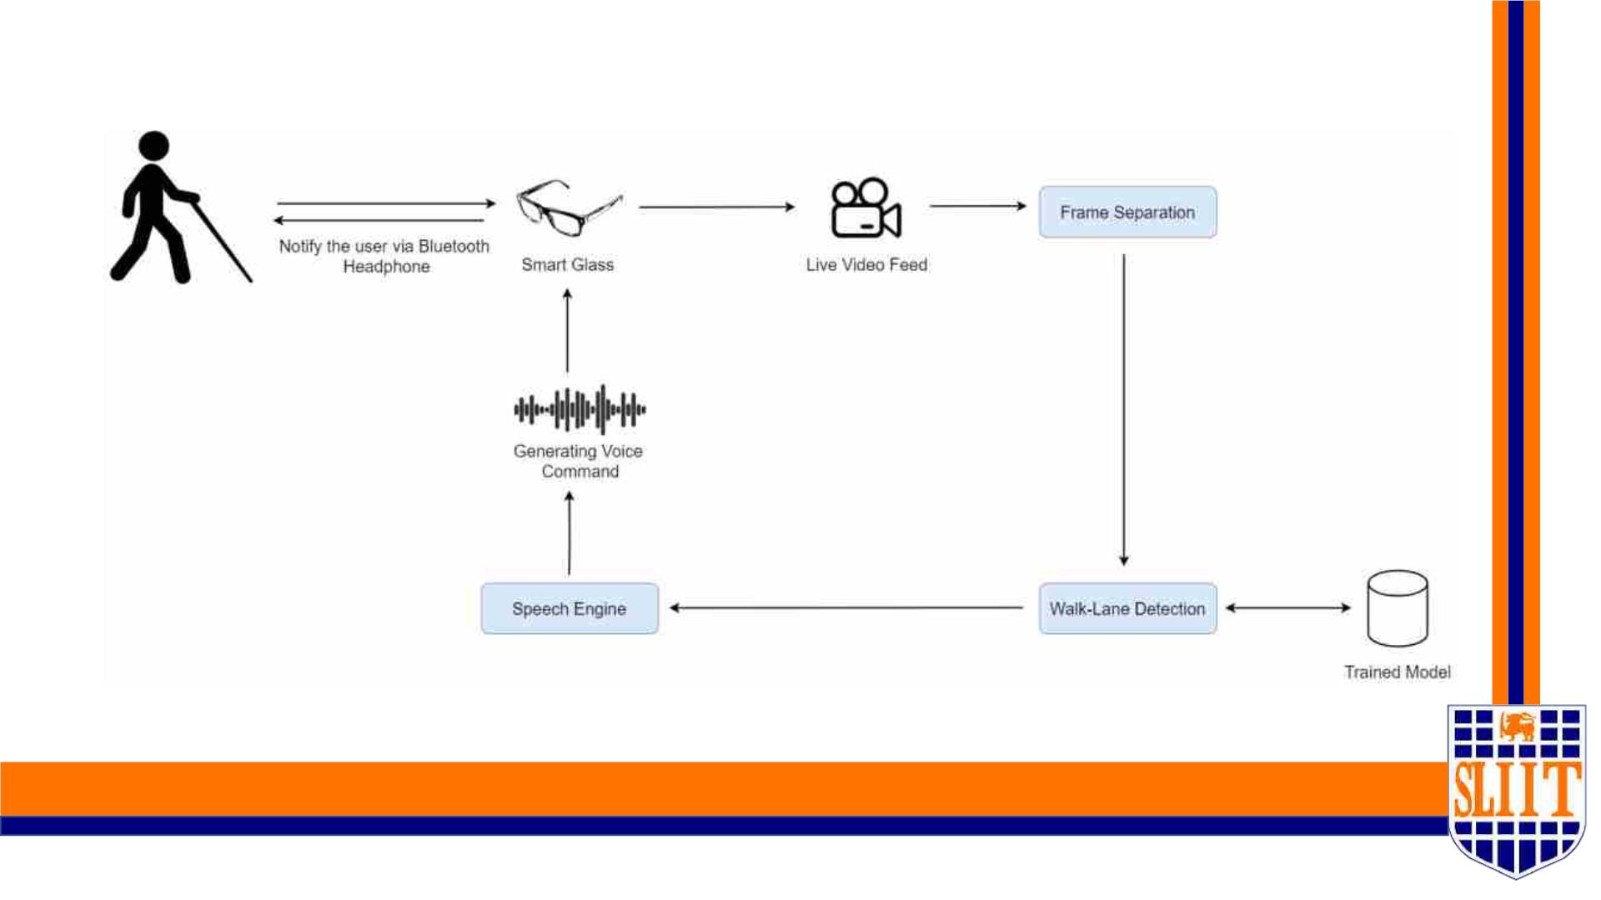
v System overview diagram
SMART NAVIGATION TOOL FOR VISUALLY IMPAIRED PEOPLE
94
IT19049878 | Jathusanan.E | 2022-227
64

Slide 65
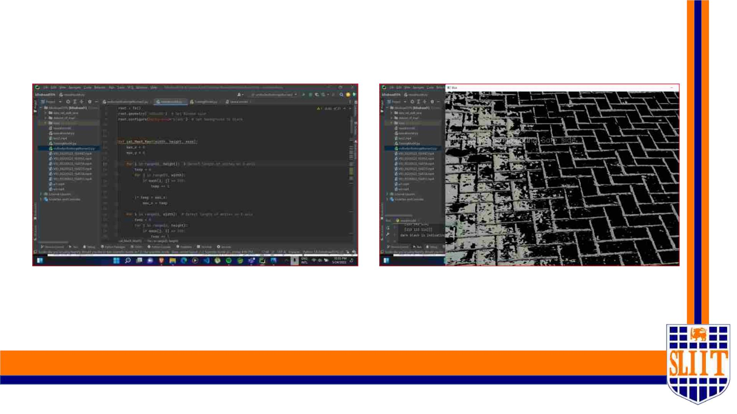
v Evidence
SMART NAVIGATION TOOL FOR VISUALLY IMPAIRED PEOPLE
95
IT19049878 | Jathusanan.E | 2022-227
65

Slide 66
References
[1] S. E, N. B. P, G. D. D and V. P, "IoT based smart walking cane for typhlitic with voice assistance," 19 November 201
[2]"Efficient Multi-Object Detection and Smart Navigation Using Artificial Intelligence for Visually Impaired People",
2022. [Online]. Available: https://www.mdpi.com/1099-4300/22/9/941. [Accessed: 11- Feb- 2022].
[3]"WeWALK | Smart Cane for Visually Impaired and Blind People - WeWALK Smart Cane", WeWALK Smart Cane, 20
[Online]. Available: https://wewalk.io/en/. [Accessed: 11- Feb- 2022].
SMART NAVIGATION TOOL FOR VISUALLY IMPAIRED PEOPLE
96
IT19049878 | Jathusanan.E | 2022-227
66

Slide 67

v Ability of Commercialization
• Identifying the target audiences.
• Create social media and flyer marketing plan in SLIIT.
• Advertise on course web and other social medias.
• Develop a pricing strategy after a year of product release.
• Send e-mail to SLIIT students about the application.
SMART NAVIGATION TOOL FOR VISUALLY IMPAIRED PEOPLE
97
67

Slide 68

SMART NAVIGATION TOOL FOR VISUALLY IMPAIRED PEOPLE
98
68

Slide 69
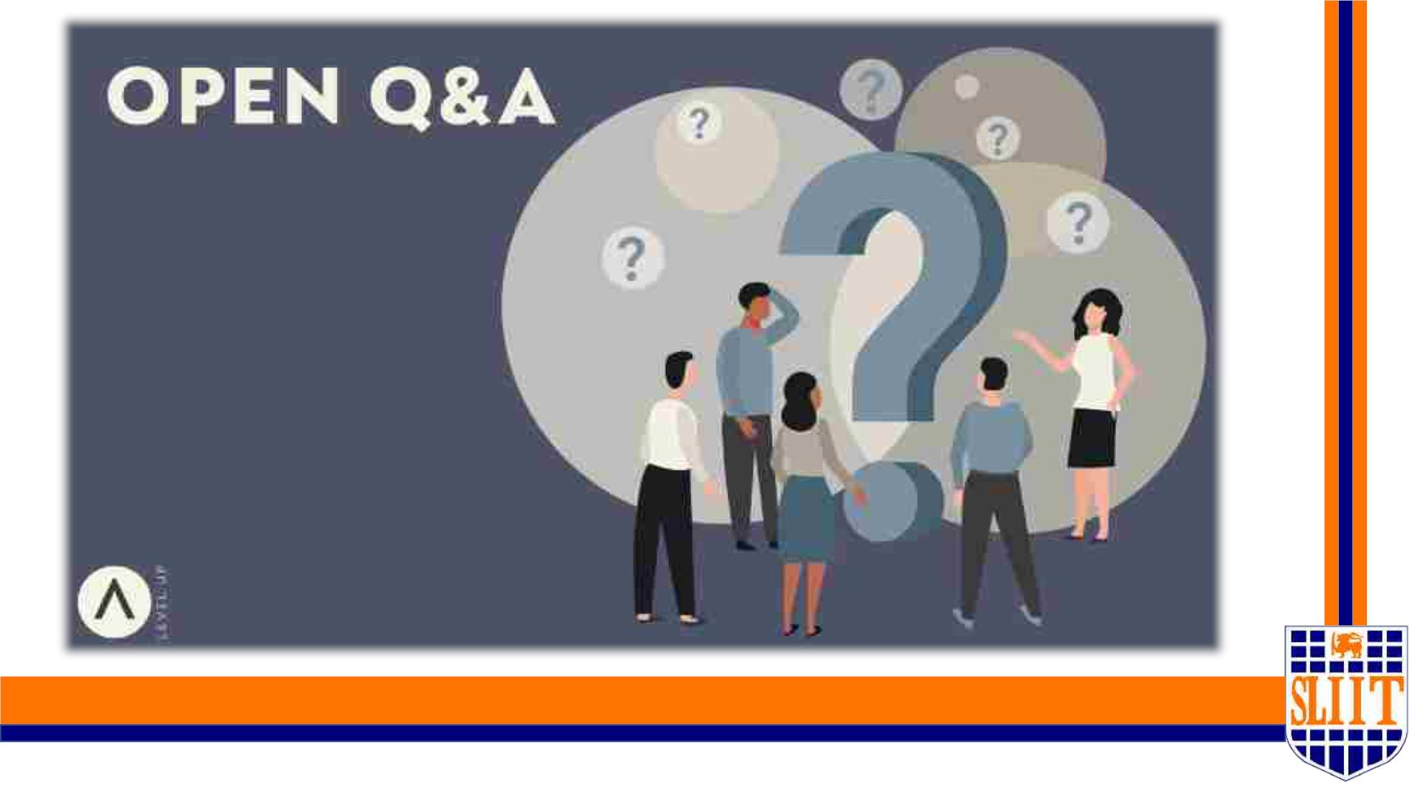
SMART NAVIGATION TOOL FOR VISUALLY IMPAIRED PEOPLE
99
69

